Slide 1
Succession
Interactions in Ecosystems: Day Three

Slide 2
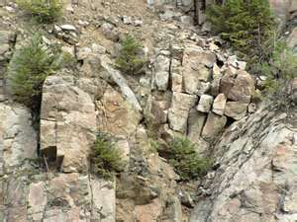
Ecological succession
Succession means the sequence of biotic changes that regenerate a damaged community in a previously uninhabited area
Ecosystems are constantly changing in response to natural and human disturbances.
When an ecosystem changes, older organisms gradually die out and new organisms move in.

Slide 3
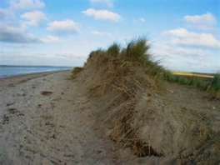
Ecological succession
Can result from slow changes in the physical environment
Sudden natural disasters or human activities also play a role in ecological succession
Ecological succession can be
Primary
Secondary

Slide 4
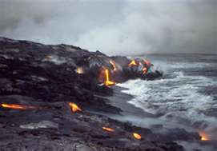
Primary succession
Establishment and development of an ecosystem in an area that was previously uninhabited
Occurs on land where no soil exists
Occurs on surfaces formed as volcanic eruptions build new islands or cover the land with lava rock or volcanic ash
Can also occur on bare rock

Slide 5
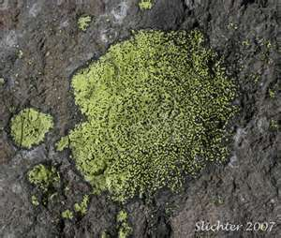
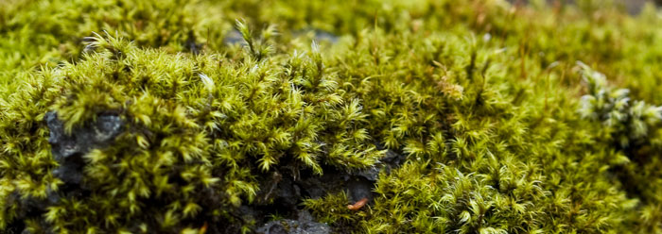
Primary succession
First, lichens that do not need soil to survive grow on rocks
Lichens are made up of fungus and algae; helps break up rocks
Next, mosses grow to hold the newly made soil
Each of these are known as a pioneer species
Meaning these are the first species to populate an area

Slide 6
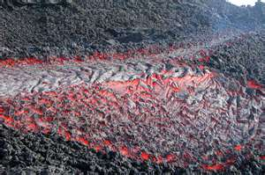
Primary succession
Soil starts to form as lichens, weather, and erosion help break down rocks into smaller pieces
When lichens die they decompose, adding organic matter to the rock to make soil

Slide 7
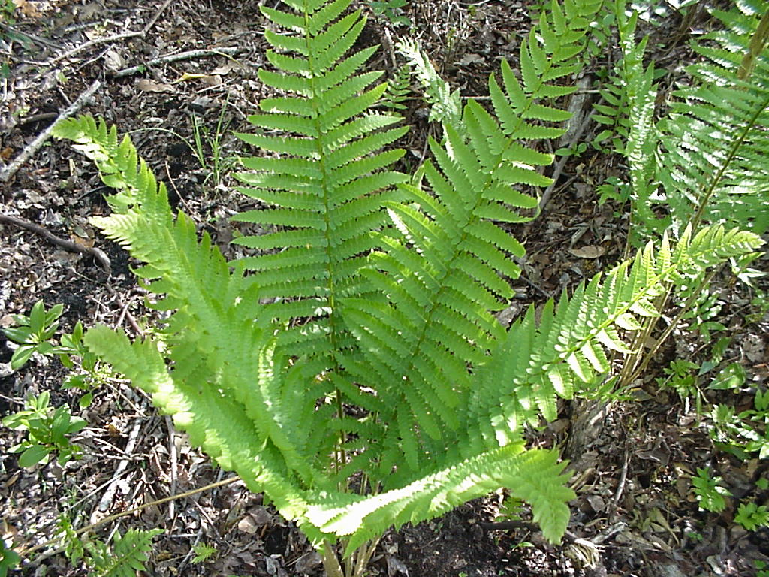
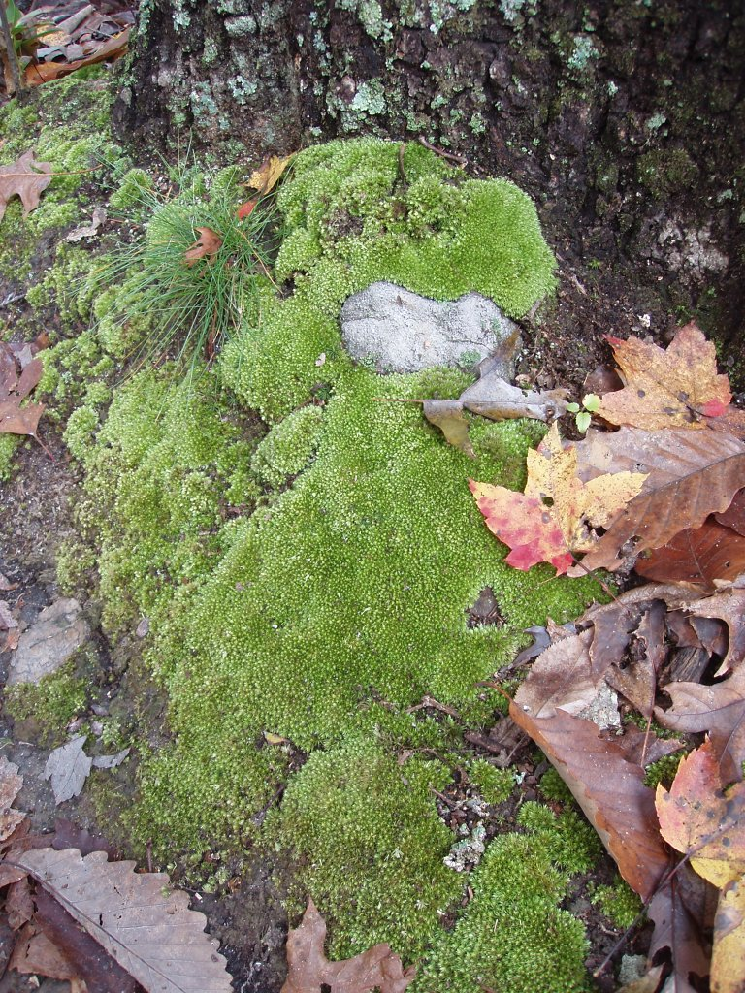
Primary succession
Simple plants like mosses and ferns can grow in the new soil

Slide 8
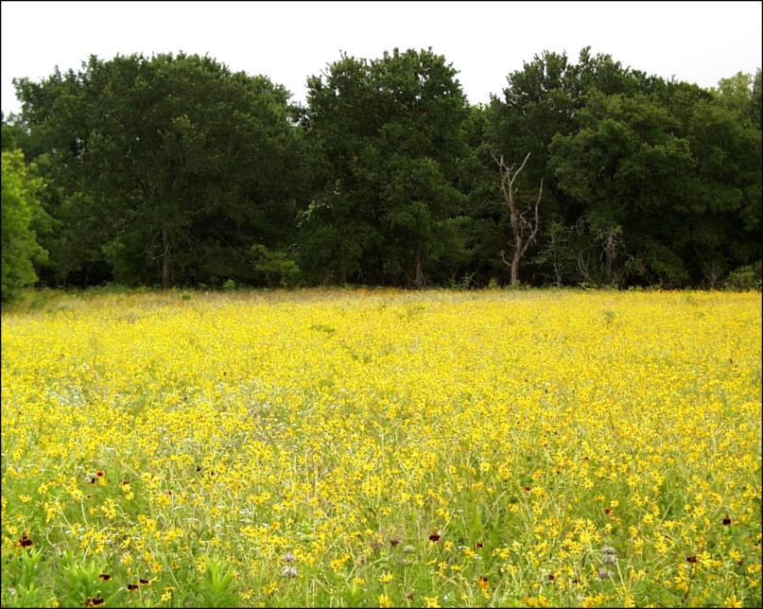
Primary succession
Simple plants die, adding more nutrients to the soil
Soil layer thickens
Grasses and wildflowers begin to take over

Slide 9
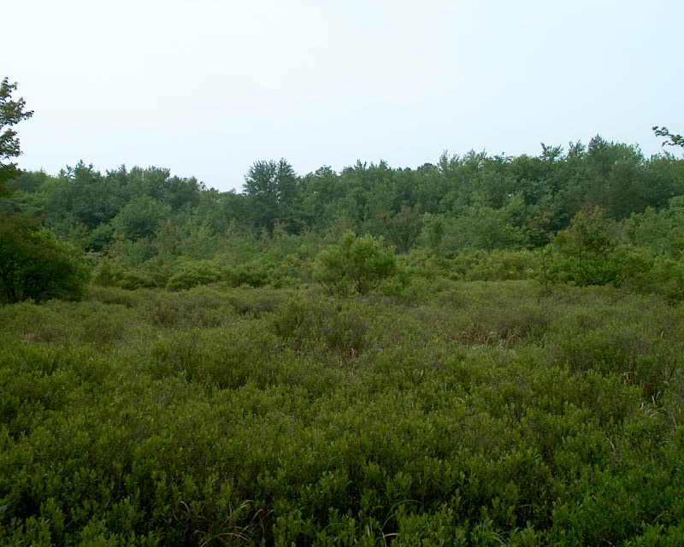
Primary succession
Grasses and wildflowers will die, adding nutrients to the soil
Shrubs and trees can survive now

Slide 10
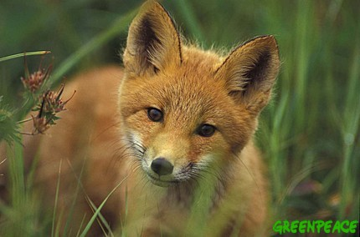
Primary succession
Insects, small birds, and mammals begin to move into the area
What was once bare rock, can now support an area of life

Slide 11
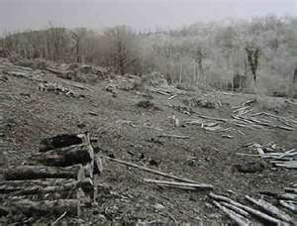
Secondary succession
Begins in a place that already has soil and was once the home of living organisms
Occurs faster and has different pioneer species than primary succession
Often see this after a natural disaster such as a forest fire or volcano

Slide 12
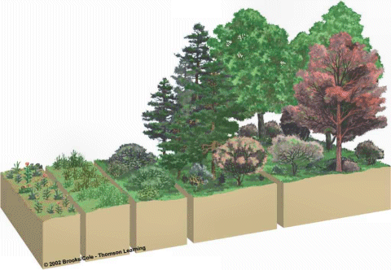

Slide 13
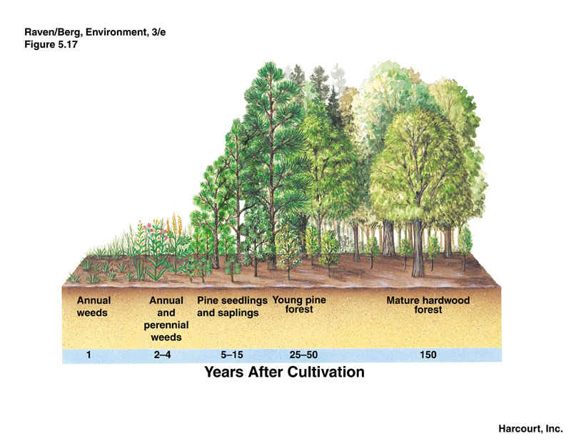

Slide 14
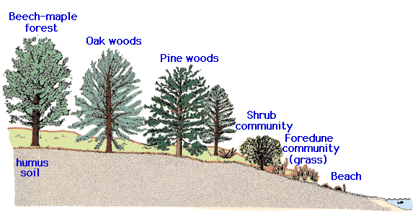

Slide 15
Climax community
A stable group of plants and animals that is the end result of the succession process
Final and stable community
Does not always mean big trees
Grasses in prairies
Cacti in deserts

Slide 16
Climax Communities
Climax Communities

Slide 17
Ecological Succession

Slide 18
Ticket Out the Door
What is ecological succession?
What is primary succession?
The first species to populate an area when primary succession begins are called _________________.
When a disturbance changes a community without removing the soil, what follows?
An area that was once referred to as a climax community without removing the soil, what follows?

