Slide 1
Populations
Interactions in Ecosystem: Day Two

Slide 2
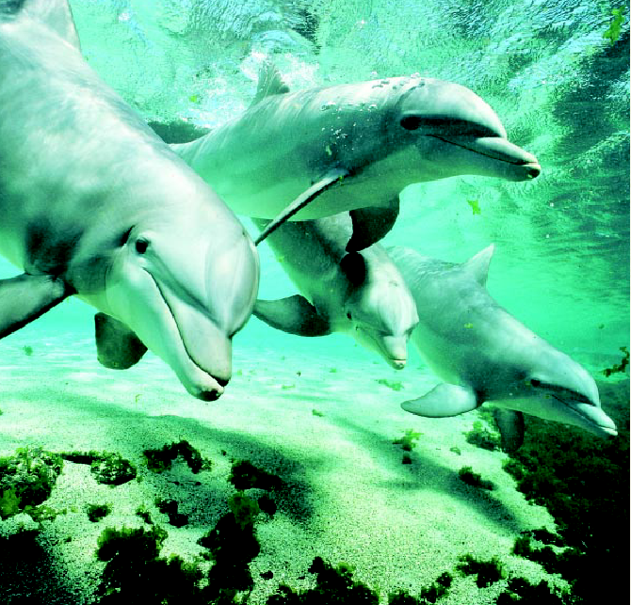
Populations
What is a population?
A group of the same species of organism living in the same place.

Slide 3
Characteristics of Populations
How do populations grow?
Four important characteristics of a population are:
Geographic distribution
Population density
Growth rate
Age structure

Slide 4
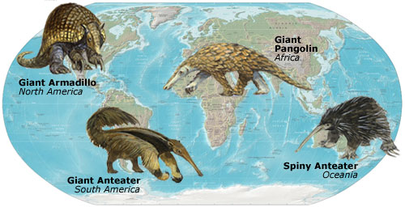
Geographic Distribution
May also be called it’s range
Describes the area inhabited by a population
Varies in size depending upon the type of organism

Slide 5
Geographic dispersion
Shows how individuals in a population are spaced
Allows ecologists to study population dispersion
Way in which individuals of a population are spread in an area or a volume
Three types of population dispersion:
Clumped dispersion
Uniform dispersion
Random Dispersion

Slide 6
Clumped dispersion
Individuals live close together in groups in order to facilitate mating, gain protection, or access food

Slide 7
Uniform dispersion
Individuals living at specific distances from one another
Caused by territoriality and intraspecific competition

Slide 8
Random dispersion
Individuals are spread randomly within an area or volume

Slide 9
Population Dispersion
http://nicolellawhhs.weebly.com/unit-5-chapter-14-interactions-in-ecosystems.html

Slide 10
Population density
Number of individuals per unit area (defined space)
Varies greatly depending on the species and ecosystem
Measures the “crowdedness” of an area
Population density =
# of individuals
area (units²)

Slide 11
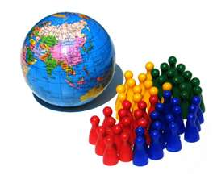
Population growth
Affected by three factors
Number of births
Number of deaths
Number individuals that enter and leave the population
Immigration – movement INTO an area
Emigration – movement OUT of an area

Slide 12
Ticket Out the Door
What are four main characteristics of a population?
What is a population’s geographic distribution?
Another term for geographic distribution is ____________________.
What is population density?
What three factors affect population size?
If more individuals are born than die in any period of time, how will the population change?
Complete the table about changes in population size.
Type of Change | Definition | Resulting Change in Size
Immigration
Emigration

