Slide 1
Population Growth
Interactions in Ecosystems

Slide 2
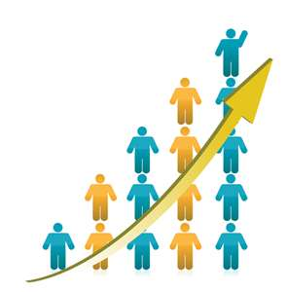
Population growth based on available resources
Growth is a function of the environment
Directly determined by the amount of resources available
Two distinct types of population growth
Exponential
Logistic

Slide 3
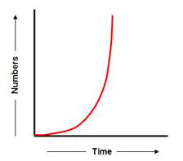
Exponential growth
Population has abundant space and food
Occurs when the individuals in a population reproduce at a constant rate
Lack of limiting factors (causes population growth to decrease)
Shown as a J-shaped curve in a graph
Examples: bacteria!

Slide 4
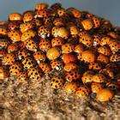
More on exponential growth
When a population has unlimited resources and continues to grow to its full living potential, it is called its biotic potential.
A population that has reached biotic potential has reached its maximum reproductive capacity.
That means it has reproduced as much as it can!

Slide 5
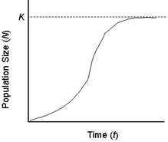
Logistic Growth
Occurs when the population’s growth slows or stops following a period of exponential growth
Most realistic
Caused by resources becoming less available
Influenced by limiting factors
Can slow down when birthrate decreases or death rate increases
Represented as an S-shaped curve

Slide 6
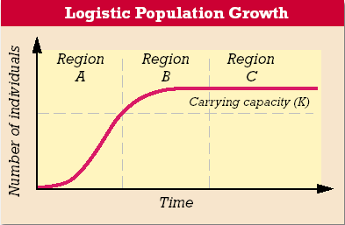
Carrying Capacity
Represented as K
Largest number of individuals that a given environment can support
Can change when the environment changes
Region A= very close to exponential growth
Region B= declining birthrate; inc. death rate
Region C= pop. reaches K; usually fluctuates around Carrying Capacity

Slide 7
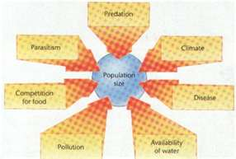
Limiting factors
Is a factor that causes population growth to decrease
Two types of limiting factors:
Density-dependent
Density-independent

Slide 8
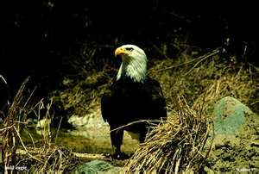
Density-Dependent Factors
Depends on population size
Becomes limiting only when the population density reaches a certain level
Density is the number of organisms per unit area
Best seen when population is large and dense
Do not affect small, scattered populations
Examples: competition, predation, parasitism, and disease

Slide 9
Competition
Occurs if crowded organisms compete for food, water, space, sunlight, and other essentials
Can occurs between members of the same species
Can also occur between members of different species…remember no two species can occupy the same niche in the same place at the same time

Slide 10
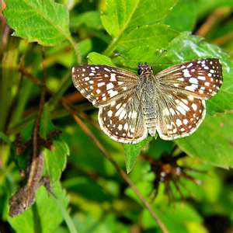
Effect of Predation
Population size often controlled by predation
Takes place in the predator-prey relationship
Best mechanism of population control

Slide 11
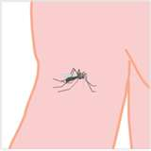
Parasitism and Disease
Limit growth of population
Take nourishment at the expense of their hosts often weakening them and causing disease and death

Slide 12
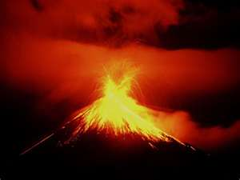
Density-Independent Factors
Affect all populations regardless of size
Examples: unusual weather, natural disasters, seasonal cycles, and human activities
Can see a population crash
Dramatic decline in the population size over time

Slide 13
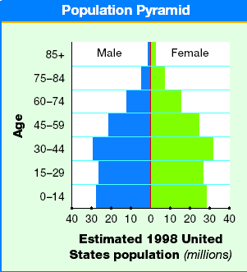
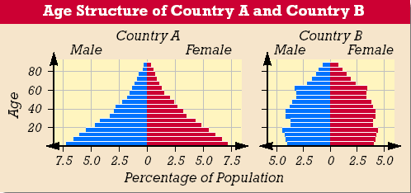
Age Structure
Population growth depends on how many people of different ages make up a given population.
Populations with large numbers of young offspring have greater potential for rapid growth
Population Pyramids or Age-Structure Diagrams show age structure in a population.

Slide 14
Patterns of Population Growth
The scientific study of human populations is called demography
Examines the characteristics of human populations and attempts to explain how those populations will change over time
Birthrates, death rates, and the age structure of a population help predict why some countries have high growth rates while other countries grow more slowly
Notes:
Talk about Thomas Malthus…pg 130.

Slide 15
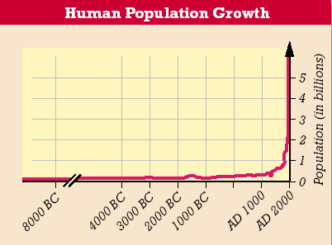
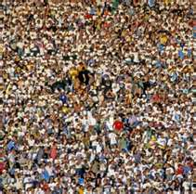
Human Population Growth
It took from the beginning of mankind to around 1800 for the human population to reach 1 billion.
In the last 200 years, the human population has reached just over 6 billion.
The U.N. estimates the world’s population to be 12.5 Billion by 2050.
What effects will these numbers have on the
Earth? Other forms of life?

Slide 16
The Demographic Transition
Over the past century, population growth in the US, Japan, and much of Europe has slowed dramatically.
One hypothesis as to why these countries have slowed in their growth is the demographic transition (a dramatic change in birth and death rates).
As countries modernize, there are advances in nutrition, medicine, and sanitation.
These result in more children surviving into adulthood and more adults living to old age.
These changes lower the death rate and begin the demographic transition.

Slide 17
Population Biotic Potential
http://nicolellawhhs.weebly.com/unit-5-chapter-14-interactions-in-ecosystems.html

Slide 18
Ticket out the Door
How will a population change if there is abundant space and food and if the population is protected from predators or disease?
When does exponential growth occur?
When does logistic growth occur?
Word Bank:
Births Emigration Deaths Immigration
When resources are abundant in a particular area, individuals may move into the population of this area. This movement of individuals into a population from a different population is called __________________.
A very cold winter has left many deer in a population hungry and sick. By the end of the winter, this population will likely decrease because of ____________________.
A deer population experiences growth when the rate of reproduction increases. This change in population size is due to ___________________.
As humans move into their territory, many members of a deer population move away and join other herds. This movement of individuals out of a population into a new population is called _______________________.

