Slide 1
Mutualism, Parasitism, Commensalism
Interactions in Ecosystems: Day One Continued…

Slide 2
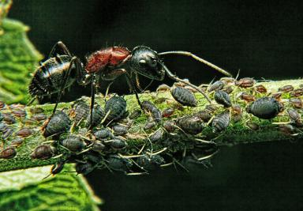
Mutualism
Both species benefit from the relationship.
Example:
Ants and aphids: Ants get a sugary substance from the aphid while the aphid receives protection from predators.

Slide 3
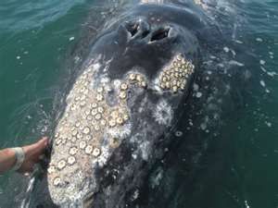
Commensalism
One organism benefits while the other is unaffected.
Example:
Barnacles on whales: Barnacles “hitch” a ride on the whale gathering food during transport; the whales receives nothing out of the relationship

Slide 4
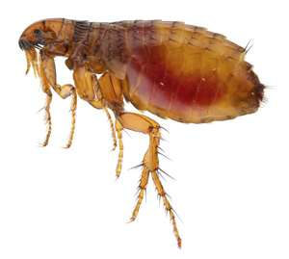
Parasitism
One organism benefits while the other is harmed.
Examples:
Flea and dog: Flea gets home/food while the dog is harmed because the flea feeds on its blood!

Slide 5
Parasites
Two types of parasites:
Ectoparasite: lives on the outside of an organism, attaching itself to the outside of the host
Examples: fleas, ticks, and leeches
Endoparasite: found on the inside of living organisms, feed on nutrients ingested by their host
Examples: tapeworms and hookworms

Slide 6
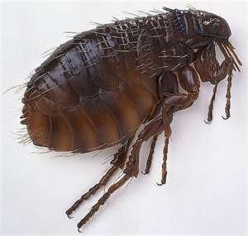
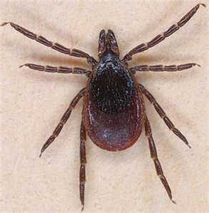
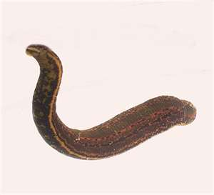
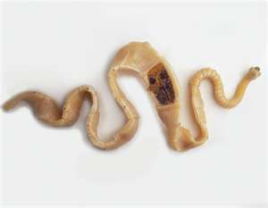
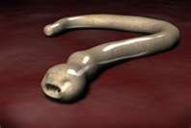

Slide 7
Symbiotic Relationships – Untamed Science
http://nicolella.weebly.com/unit-5-chapter-14-interactions-in-ecosystems1.html

Slide 8
Ticket out the Door
Determine which ecological factors are a part of a lion’s niche and which are a part of a lion’s habitat by placing the above items in the correct column.
Items: food, hunting behavior, other lions, trees, watering hole, wildebeast, zebra, sand, temperature, grass, savanna
What are the three possible outcomes of competitive exclusion?
What are ecological equivalents?
Complete the table about main classes of symbiotic relationships.
The organism from which a parasite obtains nutritional needs is called a(an) _________________________.
Habitat | Niche
Class | Description of Relationship
mutualism
commensalism
parasitism

