Slide 1
Continental Drift & Plate Tectonics

Slide 2
Continental Drift Theory
First proposed by Alfred Wegener in 1912:
250 million years ago, all of the continents were combined into one super-continent called “Pangaea”
The continents gradually drifted apart to where they are today
Wegner didn’t make up this theory out of the blue – like all scientists, he based it on evidence

Slide 3
Evidence Summary
Geographic fit of South America and Africa
Fossils match across oceans
Rock types and structures match across oceans
Ancient glacial features

Slide 4
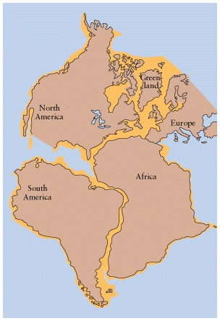
Geographic Fit
Continents look like they could be part of a giant jigsaw puzzle
Here’s how they moved apart

Slide 5
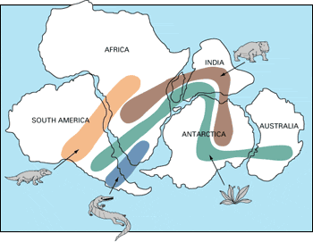
Fossils Match
Plant and animal fossils found on the coastlines of different continents

Slide 6
Fossil Fuel in Antarctica
Tropical plant remains (coal deposits) found in Antarctica
this is evidence that Antarctica was once much warmer and much closer to the equator, since tropical plants don’t grow in Antarctica today

Slide 7
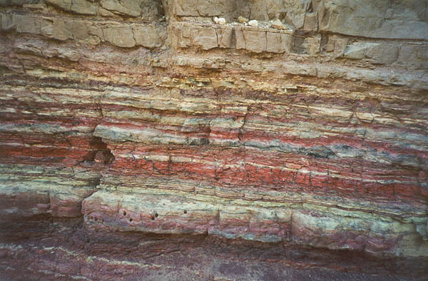
Rock Structures Match Across Oceans
Same rock patterns found in South America, India, Africa, Antarctica and Australia

Slide 8
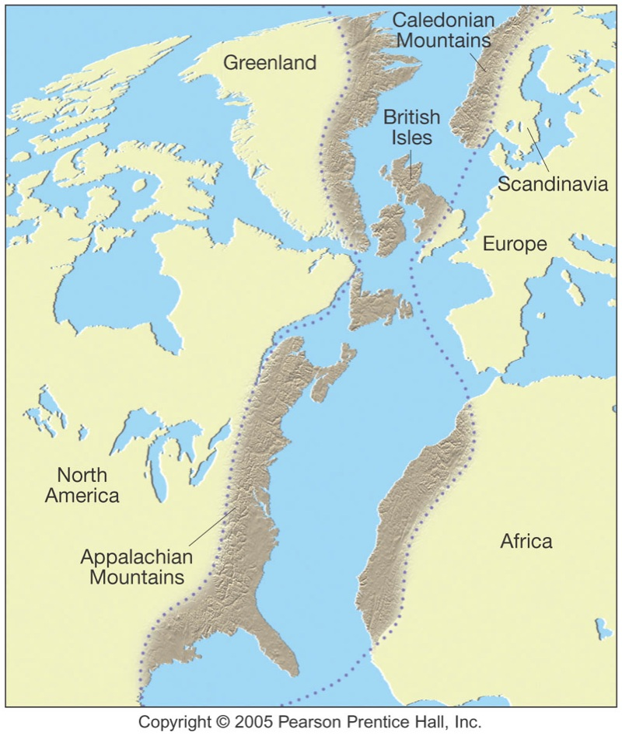
Rock Structures Match Across Oceans

Slide 9
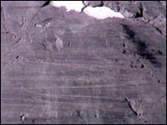
Ancient Glacial Features
Glaciation in Africa, South America, India, and Australia during the same time

Slide 10
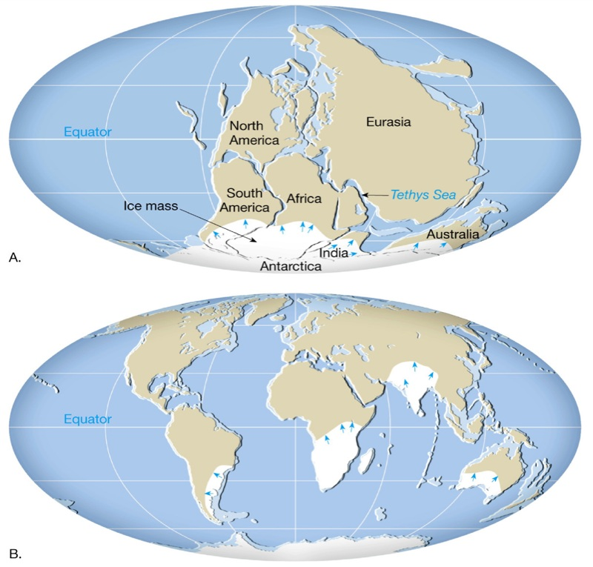
Ancient Glacial Features

