Slide 1

INTERACTIVE SCIENCE NOTEBOOK
“Your Key To Success in Science”
Science
Notebook
Presented by
Dean Oey

Slide 2
Have you ever heard yourself say .
I can't find my . . .
notes, homework, old quizzes . . .
I can't remember what
we did in class yesterday.
I'm sure its in . . .
my locker . . .
my book bag . . .
my room . . .
I was absent last week, did I miss anything?

Slide 3
Well Here's Your Answer..
Interactive
Notebook
Science
Notebook

Slide 4
What is An Interactive Notebook
An interactive science notebook (ISN) is your own personalized DIARY of learning about science
A portfolio of your work in ONE convenient spot. This is great for studying for upcoming quizzes & tests
A great ORGANIZATIONAL tool that gives you permission to be PLAYFUL AND CREATIVE in your responses without "messing up" your notes.
Allows you to be like a REAL SCIENTIST!
Science
Notebook

Slide 5
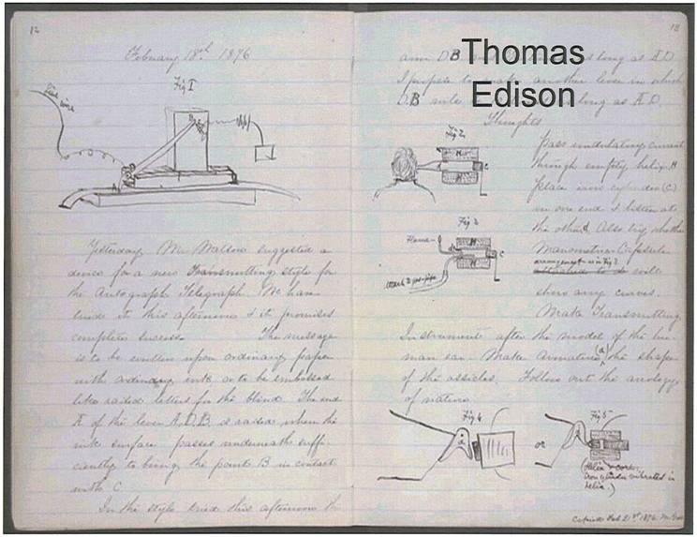
Real Scientist Use Notebooks

Slide 6
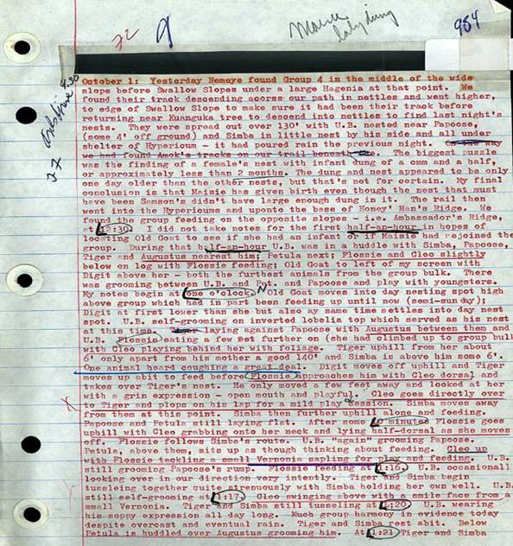
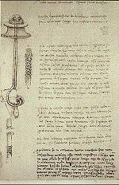
Real Scientist Use Notebooks
DIAN
F OSSEY
LEO
DIVINCI

Slide 7
The notebook is divided into TWO sections.
Left Side-Right Side: WHICH SIDE?
The Right SIDE is “RESTRICTED to DIRECT INSTRUCTION” and contains only information given by Mr. Oey Nothing else should be placed on the Right SIDE!!
The Left side “LOVES” student work. This is the side that you can use to show me your creativity. This is the “output” or product side.

Slide 8

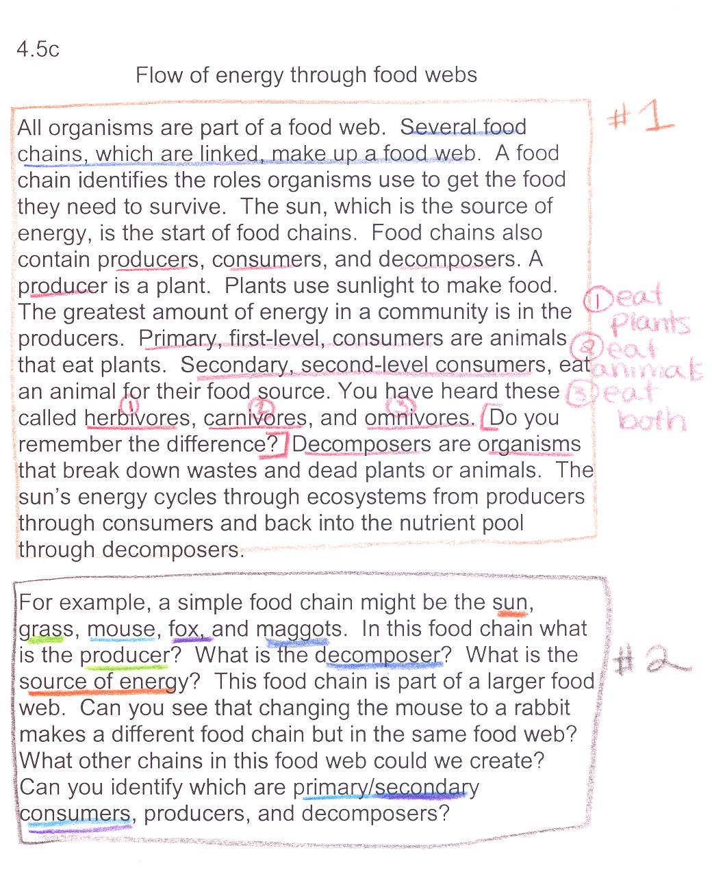
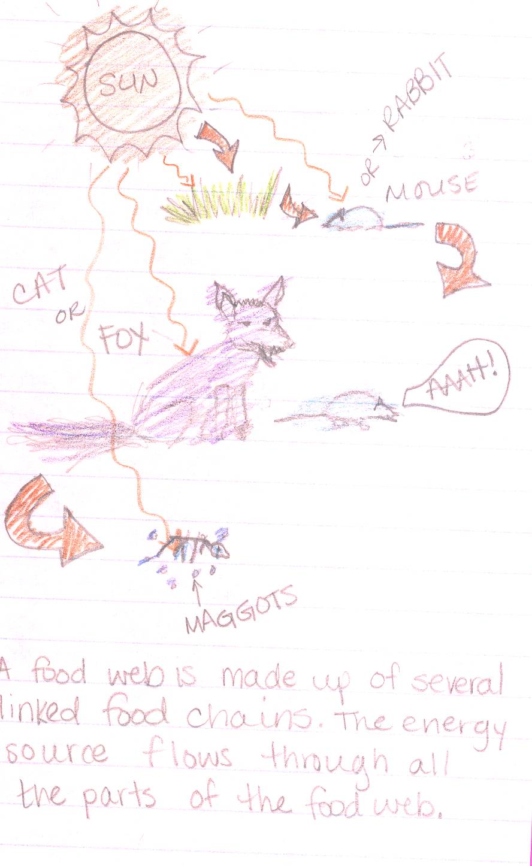
The notebook is divided into TWO sections.
LEFT side “loves”
STUDENT work = OUTPUT
RIGHT side is “restricted” to TEACHER INPUT
Fill in the missing word.
Decomposer Producer Consumer
Plants are ____. Lions, tigers, and bears are ____. Worms and mushrooms are____

Slide 9
LEFT SIDE: YO SIDE
The LEFT SIDE belongs to you.
On this page you may include diagrams, cartoons, drawings, poems, foldables, etc. Let your CREATIVITY go wild!
EVEN PAGES =2, 4, 6, 8, 10…YOU GOT IT..

Slide 10
Examples of Left Side Assignments
Graphic Organizers
Drawings/Illustrations
Poems, Rap Songs
Cartoons/Comics
Lab Analysis
Teach Your Parent
YOUR OPPORTUNITY
TO BE
AS CREATIVE AS
YOU WANT
TO BE

Slide 11
The day’s activity is placed on the LEFT or OUTPUT side of the notebook. This section acts as a reinforcement for the RIGHT or INPUT side. This side entails hands on, tactile learning. You will also need to ask questions and deliver answers. Use the Bloom’s Question Stems at the back of your ISN as a guide.
LEFT SIDE

Slide 12
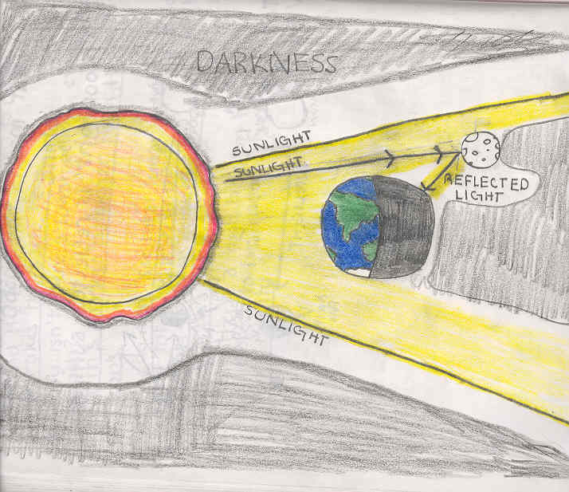
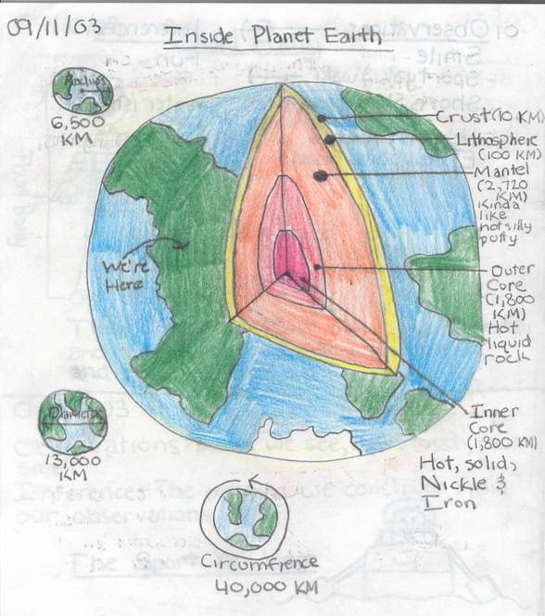
DRAWINGS/ILLUSTRATIONS

Slide 13
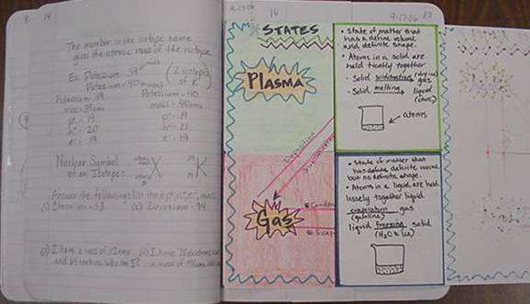
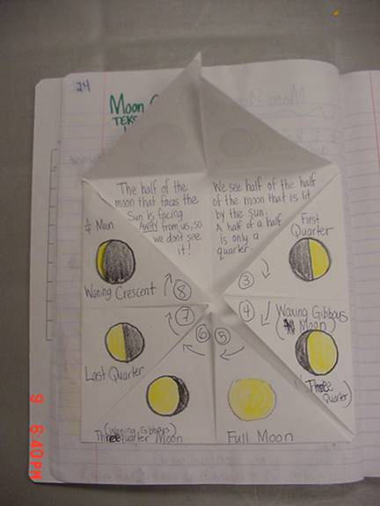
FOLDABLES

Slide 14
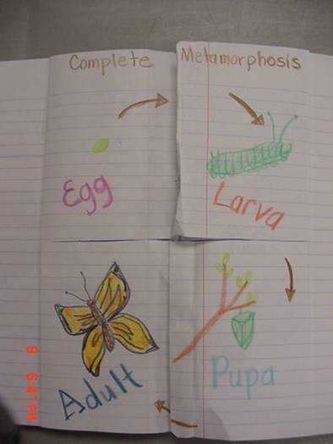
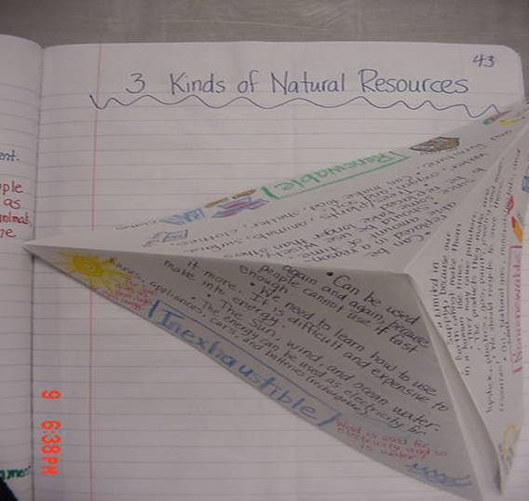
FOLDABLES

Slide 15
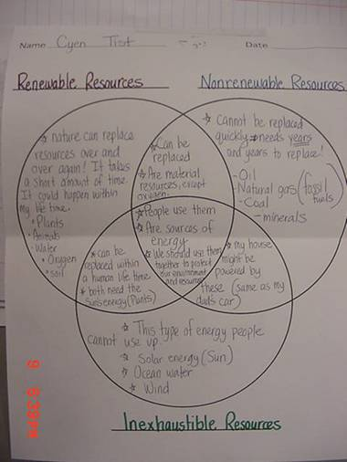
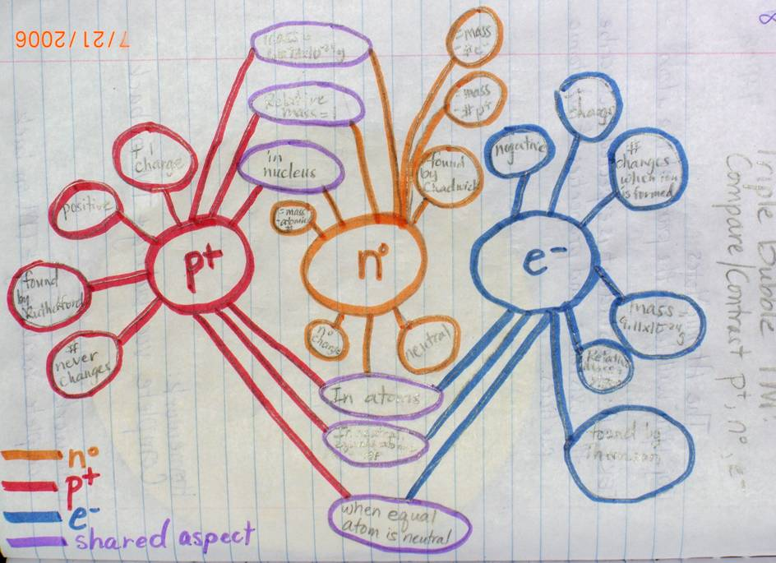
GRAPHIC ORGANIZERS

Slide 16
RIGHT SIDE: MY SIDE
The RIGHT SIDE belongs to me and should only contain information given or “input” from Mr. Oey. Nothing else should be placed on this page!
The RIGHT SIDE contains all the TESTABLE material.
Odd Pages = 1,3,5,7..YOU KNOW IT.

Slide 17
The RIGHT side of the notebook contains information given to you by Mr. Oey It has ESSENTIAL information that will DEFINITELY be on a quiz or test. Nothing else should go on this side.
RIGHT SIDE

Slide 18
Example of Right Side "Input"
Notes from
  Teacher guided Powerpoint notes
  Movie/Video
  Article Readings
Vocabulary words
Lab procedures
Study Guides
Graphic Organizers

Slide 19
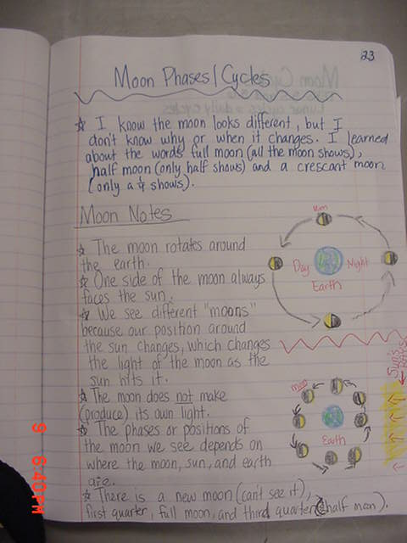
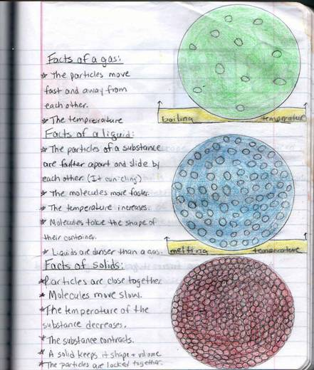
Example of Right Side "Input"

Slide 20
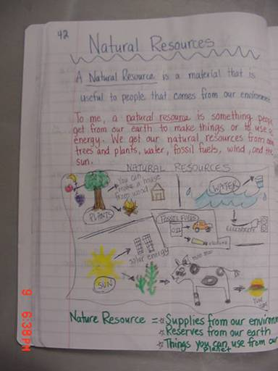
Example of Right Side "Input"

Slide 21

Science Starter
Fill in the missing word.
Decomposer Producers Consumers
Plants are _________. Lions, tigers, and bears are ________. Worms and mushrooms are_________
There will be a science starter at the beginning of class. This “warm-up” is either on the board or on Powerpoint. It acts as a review before the start of class and should be completed within the first FIVE minutes of class. Science starters are always at the back of the interactive science notebook.

Slide 22
Fill in the missing word.
Decomposers Producers Consumers
Plants are _________. Lions, tigers, and bears are ________. Worms and mushrooms are_________
Place Warm-up Activities at the back of your ISN. Let’s set-up your science starters.

Slide 23
What Students Are Saying About ISNs
“ISN's are easy to do and worth a lot of points, so take time and effort to do them well.“
"Always update your table of contents so papers don't get messed up - or in case of an ISN check.“
"An ISN is a great tool, keep it organized!“
"You have to spend quality time on your ISN.“
"Don't leave your ISN until the last day, otherwise you may be up to the early morning hours finishing assignments.“
"Colorize things. It looks so much better that way”
"Keep it in order, because you never know when a notebook check might come up.“
"Do not save your ISN until the last minute. Remember, it counts as much as a test."

Slide 24
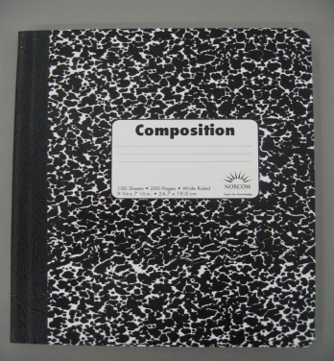

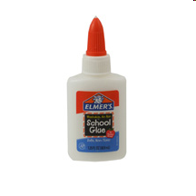
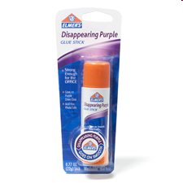


Science Notebook Supplies
Scissors
Glue or glue stick
(2 PER MONTH)
1 – Composition Notebook
Erasable pens & pencils
colored pencils
HIGHLIGHTER
NO MARKERS!

Slide 25
Getting Started: Step 1
The name of the course:
  -My Adventures in Sixth Grade Science
The words: Interactive Science Notebook
The class period that you have science:
  Period 1, for example
The school year: 2013 – 2014
Your “awesome” teacher: Mr. Oey
Your name: (self explanatory)
TWO OR MORE SCIENCE PICTURES:
  You can draw, get from magazine or Internet.
My Name
My Grade
Science
Notebook

Slide 26


MY ADVENTURES IN SCIENCE
INTERACTIVE
SCIENCE
NOTEBOOK
YOUR NAME
YOUR Period
Mr. Oey
2013-2014

Slide 27
STEP 2
Starting with the 1st page, number the first 50 pages. The 1st page is X. Numbers should be small and at the bottom outside corner of every page.
TABLE OF CONTENTS
TABLE OF CONTENTS
AUTHORS PAGE
“ALL ABOUT YOU PAGE”
1
2
3
X
(Skip pages 0-5..These will be REFERENCE PAGES)

Slide 28
STEP 3
At the bottom of PAGES 2, 3, & 4, glue-in Table of Contents. Always provide Description Title, & Page #
3
TABLE OF CONTENTS
4
5
6
Class Policies
Class Policies
Guidelines

Slide 29
STEP 4
On page 5-8, you will glue class handouts. On page 9, you will create your Unit Page
7
8
9
Unit Title Page
BECOMING A SCIENTIST
Create a colorful Drawing or get pics that relate to the unit we are studying
Be Colorful
LAB SAFETY CONTRACT
ISN GUIDELINES
ISN GUIDELINES

Slide 30
TABLE OF CONTENTS
DATE | DESCRIPTION | PAGE # | Grade/ Stamp

Slide 31
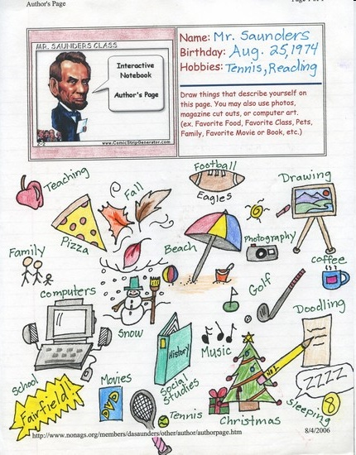
Sample
Author
P a g e
Mr. Oey

Slide 32


NOTEBOOK RULES..
No RIPPED OUT pages or torn corners
No DOODLING that doesn’t relate to science
Notebook should only be used for SCIENCE CLASS ONLY
DATE AND NUMBER each page
All entries must go into the Table of Contents
BE COLORFUL & LOVE YOUR NOTEBOOK

Slide 33
WE ARE READY!
Science
Notebook

Slide 34
CREDITS
Many thanks to these wonderful teachers for creating wonderful POWERPOINT slides from
  Dean Oey, rockin’ Science
  ScienceNotebook.com, great resource

