Slide 1
Habitat
Interactions in Ecosystems: Day One

Slide 2
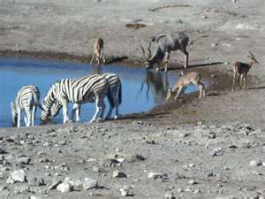
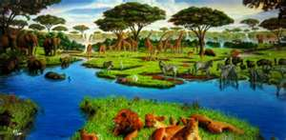
Habitat versus Niche
Review!
What is a habitat?
All of the biotic and abiotic factors in the area where an organism lives.
Examples: grass, trees, and watering holes!
Where it lives!

Slide 3
Habitat versus Niche
Review!
What is a niche?
Composed of all of the physical, chemical, and biological factors that a species needs to survive
Niche includes: type of food a species eats, tolerating certain types of abiotic conditions, and a species’ behavior.
How it lives!
Habitat is like an address in an ecosystem and a niche is like the job in an ecosystem.

Slide 4
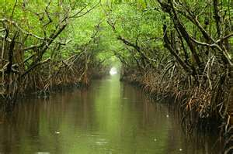
Resource availability
Provides structure to communities
What is a community?
Different groups of species
Many species share similar habitats and use some of the same resources
Florida Everglades

Slide 5
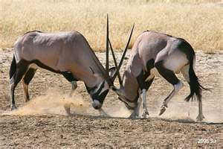
Competitive Exclusion
Can present a problem if two species use the same resource in the same way
One species will always be better adapted to the environment.

Slide 6
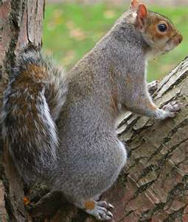
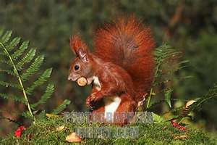
Competitive Exclusion
States that when two species are competing for the same resources, one species will be better suited to the niche, and the other species will be pushed into another niche or become extinct.
Example:
In Great Britain, North American gray squirrel (better suited) introduced and pushed out the native European red squirrel.
Caused red squirrel population to decline rapidly.

Slide 7
Other outcomes from competitive exclusion
Niche partitioning:
Divide resources based on competitive advantages
Evolutionary response:
Different sizes of teeth could affect the way they eat

Slide 8
Competitive Exclusion Principle
http://nicolella.weebly.com/unit-5-chapter-14-interactions-in-ecosystems1.html

Slide 9
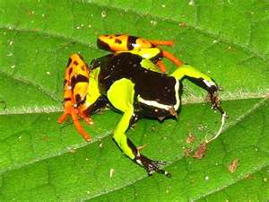
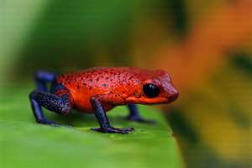
Ecological equivalents
Are species that occupy similar niches but live in different geographical regions.
Examples: Mantella frog of Madagascar and poison dart frog of South America
Both have the same niche in similar habitats, but will never compete for the same resources because they live in different geographical regions.

Slide 10
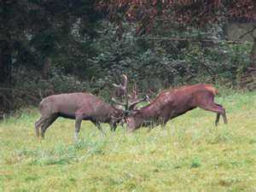
Community Interactions
Competition and predation are two important ways in which organisms interact.
Competition occurs when two organisms fight for the same limited resource.

Slide 11
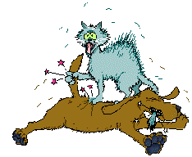
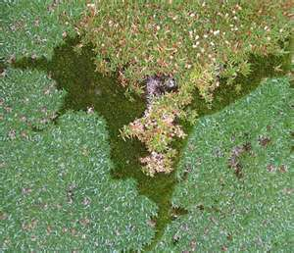
Competition
Two types of competition:
Interspecific competition:
Competition between two different species (competing for space)
Examples: cats and dogs

Slide 12
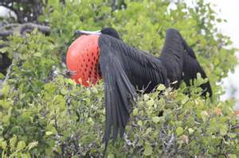
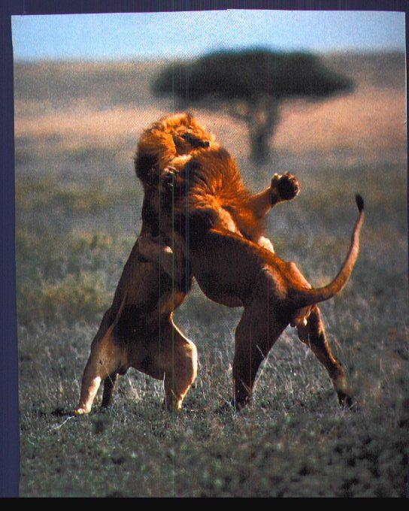
Competition
Two types of competition:
Intraspecific competition:
Competition between members of the same species
Examples: male birds, lions

Slide 13
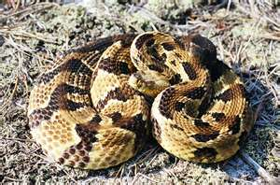
Predation
Process by which one organism captures and feeds upon another organism.
Timber Rattlesnake

Slide 14
More Community Interactions
Symbiosis:
Any relationship where two species live closely together and interact.
3 types:
Mutualism
Commensalism
Parasitism

Slide 15
Relationships Between Organisms
http://nicolella.weebly.com/unit-5-chapter-14-interactions-in-ecosystems1.html

Slide 16
Ticket Out the Door
Complete the table about factors that influence ecosystems.
When does competition occur?
What is a resource?
What is the competitive exclusion principle?
What is predation?
When predation occurs, what is the organism called that does the killing AND eating, and what is the food source called?
Type of Factor | Definition | Examples
Biotic Factors
Abiotic Factors

