Slide 1
Catalyst
For each of the following tell where it is found and the charge:
Proton
Neutron
Electron

Slide 2
Matter Review!

Slide 3
Whiteboard Review!

Slide 4
Question 1
Give an example of a physical change.

Slide 5
Question 2
Give an example of a chemical change.

Slide 6
Question 3
Luster is a physical property. Give an example of something with luster?

Slide 7
Question 4
What does it mean if something is a “conductor”?

Slide 8
Question 5
What is a chemical change?

Slide 9
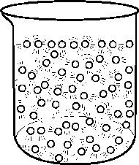
Question 6
Which phase of matter? How do you know?

Slide 10
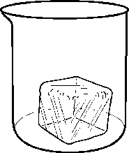
Question 7
Which phase of matter? How do you know?

Slide 11
Question 8
Which state of matter has the fastest particle motion?

Slide 12
Question 9
How do the particles in a liquid move?

Slide 13
Question 10
Which state of matter does not occur naturally on Earth?

Slide 14
Question 11
What happens at a substance’s freezing point?

Slide 15
Question 12
What happens at a substance’s melting point?

Slide 16
Question 13
What happens in sublimation?

Slide 17
Question 14
What phase is produced at the end of vaporization?

Slide 18
Question 15
Which particles are located in an atom’s nucleus?

Slide 19
Question 16
What is the charge on a proton?

Slide 20
Question 17
Which subatomic particle has a negative charge?

Slide 21
Question 18
Which particle in an atom is the smallest?

Slide 22
Question 19
How are atoms and the states of matter related?

