Slide 1
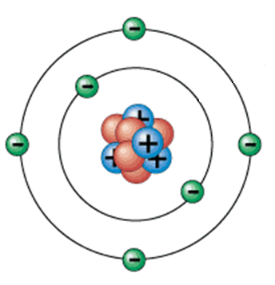
Catalyst
Draw an atom and label the parts: nucleus, proton, neutron, electron.

Slide 2
Notes: Plasma
PROPER HEADING!!!

Slide 3
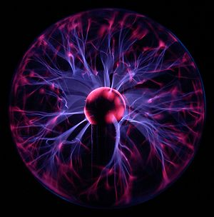
Plasma
1. A plasma is a state of matter in which electrically-charged particles move rapidly, like a gas.

Slide 4
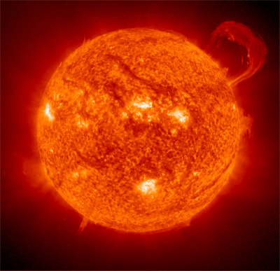
Plasma
2. Plasma is the most common state of matter.

Slide 5
Why haven’t we heard about it?
3. Plasma is not found naturally on Earth.

Slide 6
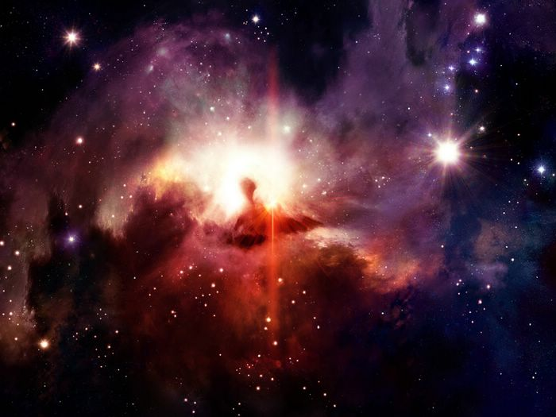
Plasma
4. Examples:
Plasma TVs
Lightning
Florescent lights
Sun, stars and throughout space

Slide 7
Atom Practice

Slide 8
Question 1
What is the positively-charge particle in an atom called?

Slide 9
Question 2
What is the charge on a neutron?

Slide 10
Question 3
Which particles can be found in the nucleus?

Slide 11
Question 4
Which particle in an atom is the smallest?

Slide 12
Question 5
Where are electrons found?

Slide 13
Question 6
What is the charge on an electron?

Slide 14
Question 7
What is the nucleus of an atom?

Slide 15
Question 8
What is the electron cloud?

Slide 16
Question 9
Which particle in an atom has a negative charge?

Slide 17
Question 10
What is an atom?

