Slide 1
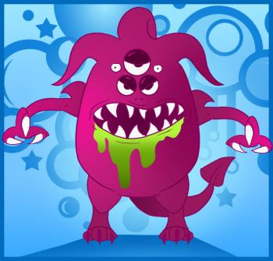
Catalyst
You are in a very dark cave and you think there is a monster in the cave with you!! You can’t see or touch the monster. What could you do to figure out what the monster looks like? (size, shape, etc.)
?
Notes:
llynn@uic.edu

Slide 2
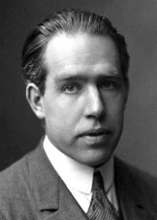
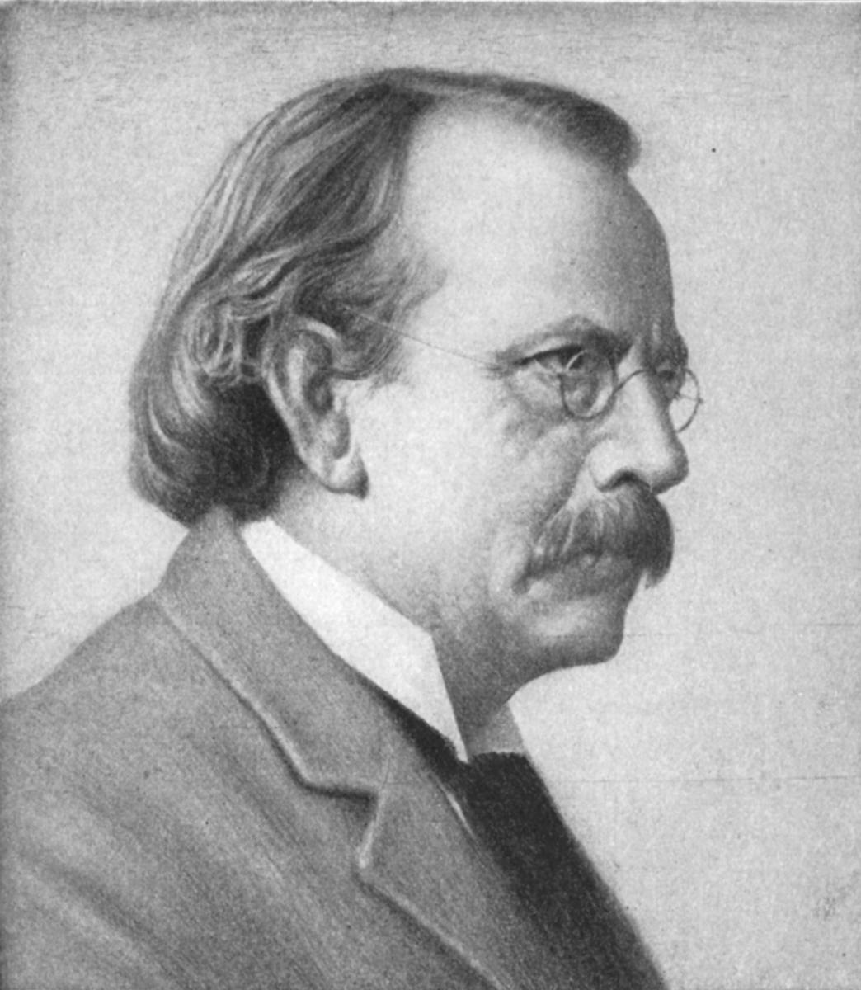
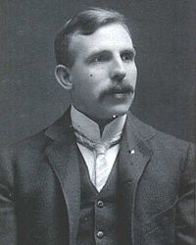
Scientists can’t see atoms so how do they know what they look like?
?
?
?
Niels Bohr
J.J. Thomson
Ernest Rutherford

Slide 3
Activity: Blinded by Science
You have a opaque canister with an object inside.
DO NOT open your canister.
Your mission is to figure out the shape, size and material of your object. Record this information in the table.

Slide 4
History of the Atom
Reading + Questions

Slide 5
Review
What is matter?
What is an atom?

Slide 6
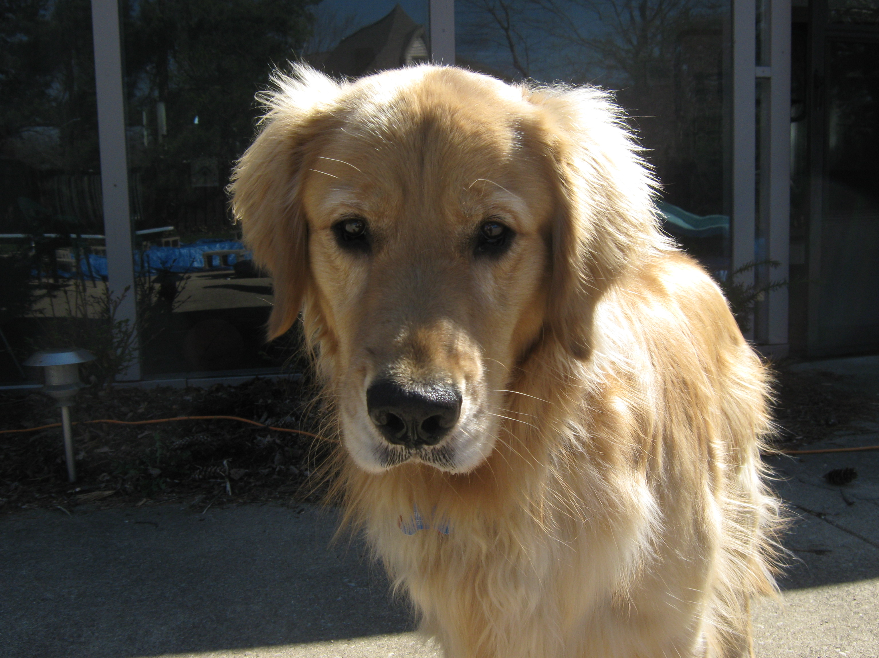
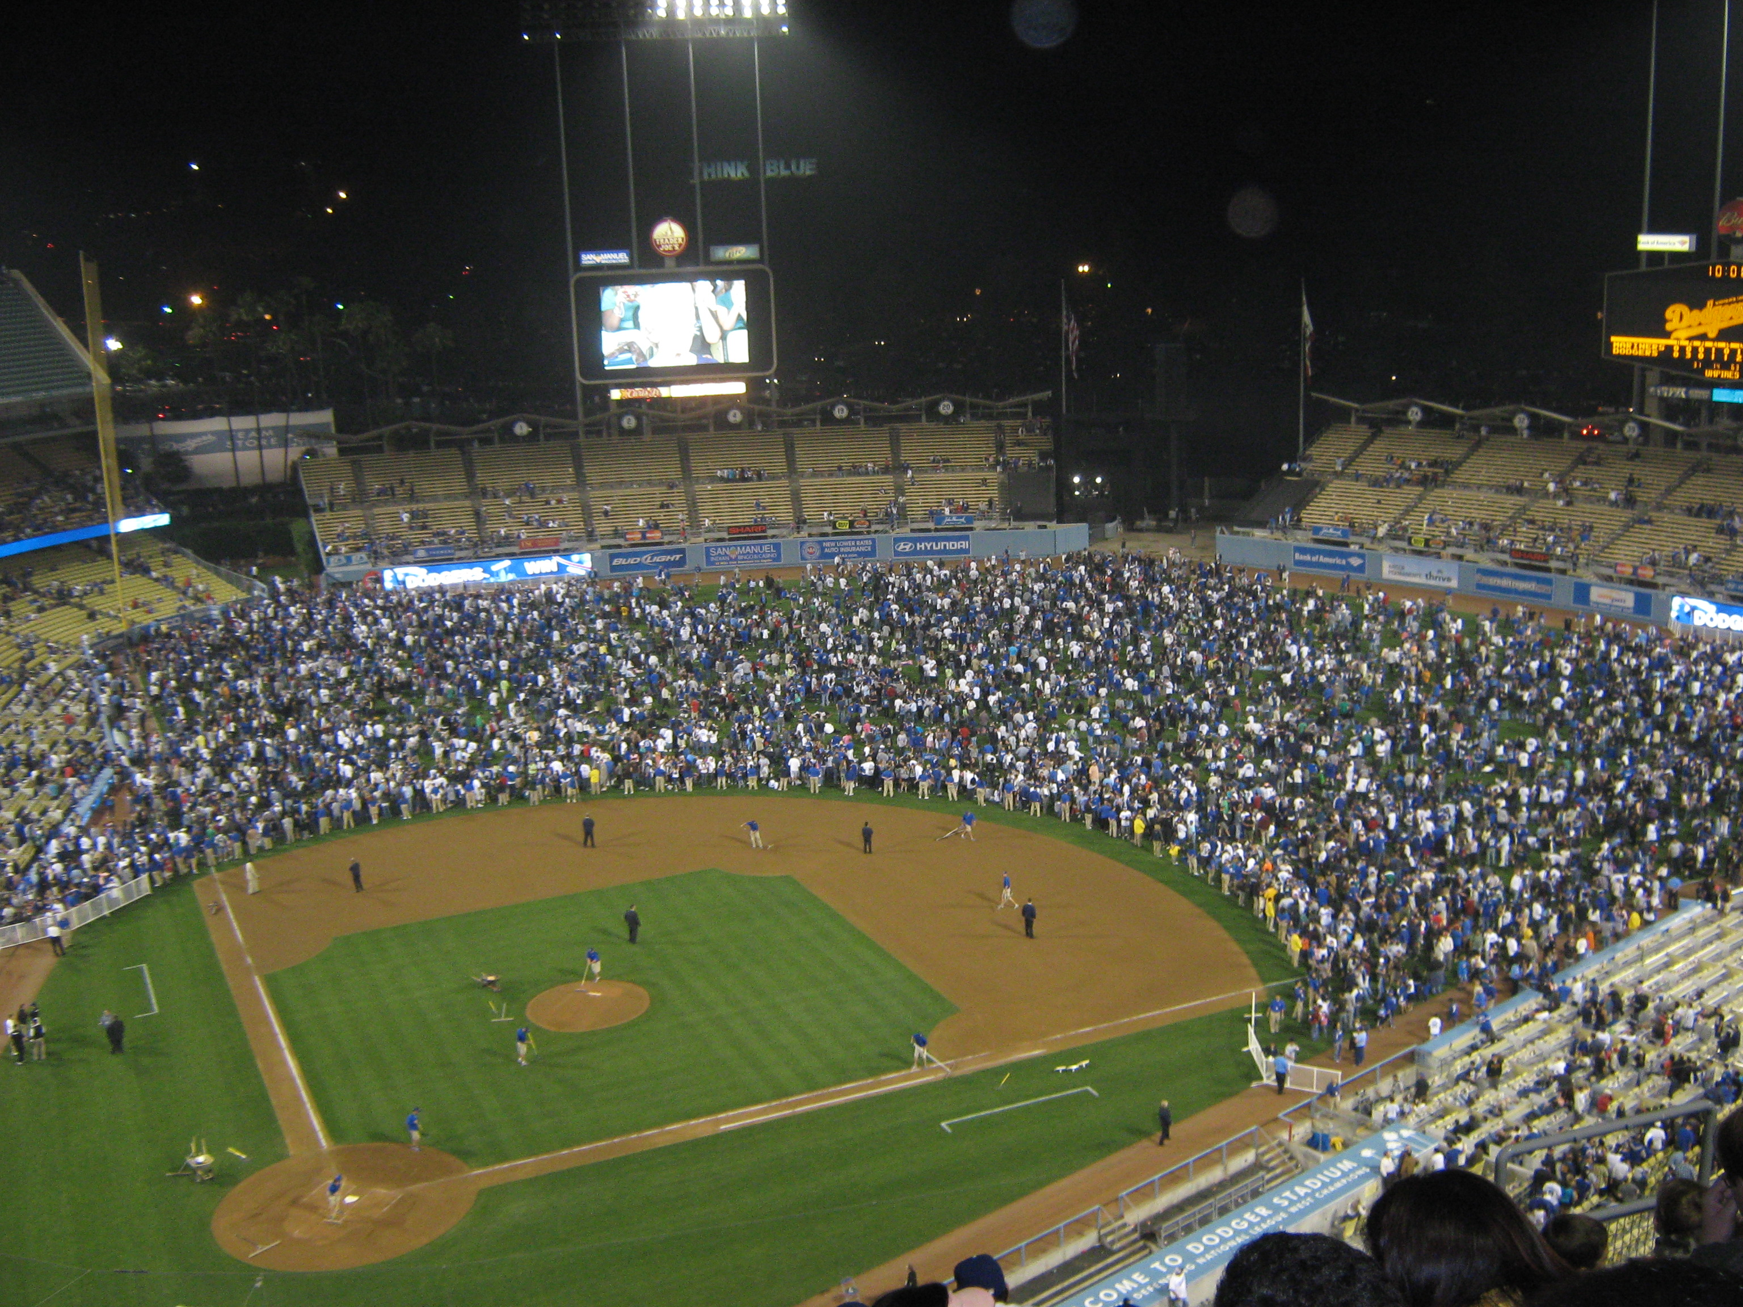
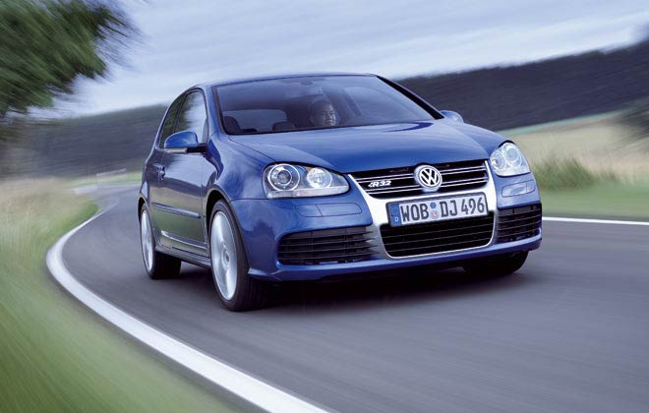
Matter
1. Anything that has mass and takes up space is matter.
What’s the matter?
EVERYTHING!

Slide 7
The Atom
2. Atoms are the tiny particles that make up all matter.
3. An atom is the smallest unit of an element that keeps the properties of that element.
“atom” is from the Greek word “atomos” which means “not able to be divided.”

Slide 8
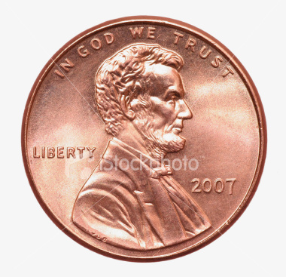
How small is an atom?
A single penny has 2 x 10²² atoms or 20,000,000,000, 000,000,000,000 atoms!
Paper cutting activity

Slide 9
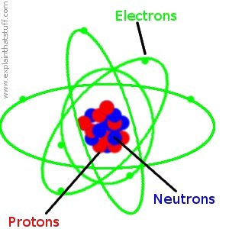
Inside the atom…
4. All atoms are made of the same 3 subatomic (smaller than an atom) particles:
Protons, neutrons and electrons.

Slide 10
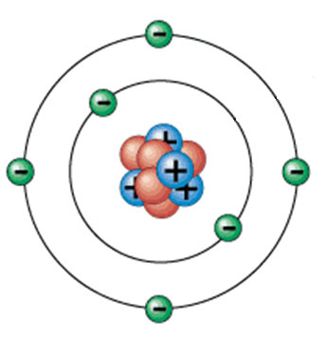
Nucleus
5. The nucleus is the dense, positively charged center of an atom.

Slide 11
Inside the Nucleus…
6. A Proton is a positively charged particle in the nucleus of an atom

Slide 12
Inside the Nucleus…
7. A neutron is a particles in the nucleus that has NO CHARGE.

Slide 13
Outside the Nucleus…
8. An electron is a small, negatively-charged particle always moving around the nucleus. Found in an area called the electron cloud.

Slide 14
The Atom
Electron
Proton
Nucleus
Neutron

Slide 15
Check For Understanding
What is the positively charged particle called?

Slide 16
Check For Understanding
Where are the electrons found?

Slide 17
Check For Understanding
What is the charge on a neutron?

Slide 18
Check For Understanding
What is the positively charged particle called?

Slide 19
The Atoms Family
http://www.youtube.com/watch?v=sshZjxmzJVI

