Slide 1
Catalyst
Give an example of a physical change and a chemical change and explain how you know it’s that type of change.

Slide 2
States of Matter, Day 2

Slide 3
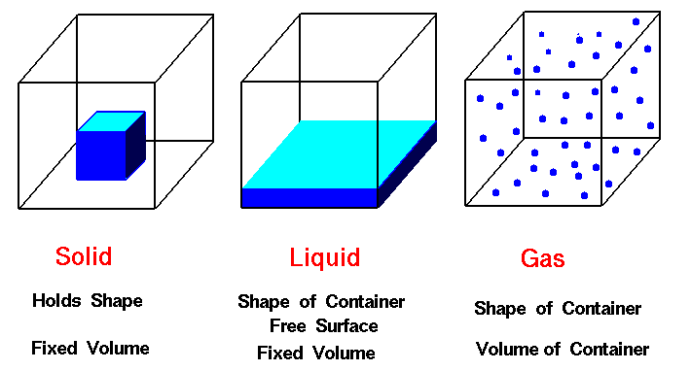
Check it Out!

Slide 4
But what do the atoms look like?
Solid
Liquid
Gas

Slide 5
Project!

Slide 6
Physical or Chemical?
Haircut!

Slide 7
Physical or Chemical?
Making Kool Aid

Slide 8
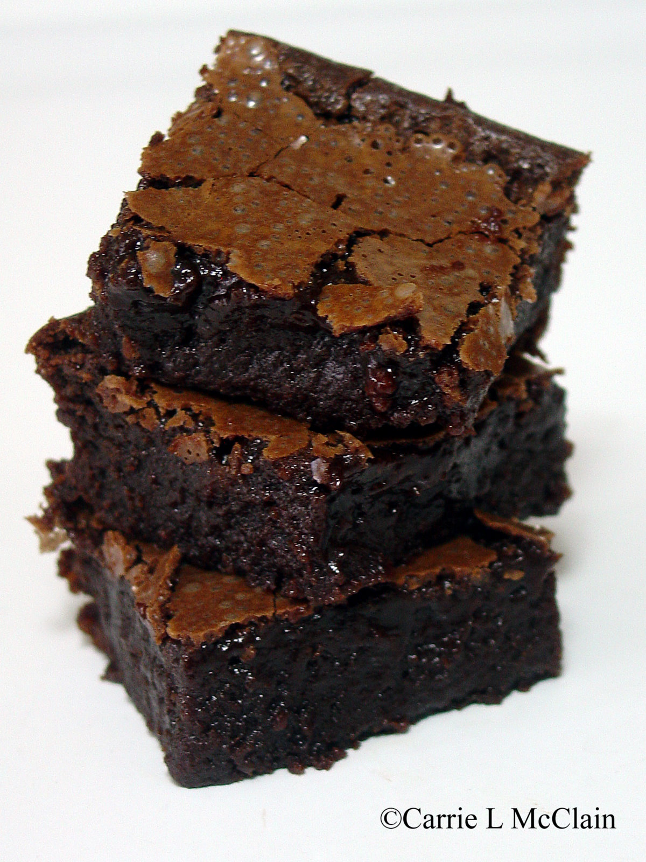
Physical or Chemical?
Making
Brownies

Slide 9
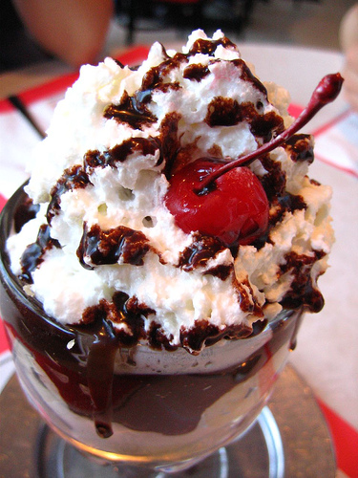
Physical or Chemical?
Making a sundae

Slide 10
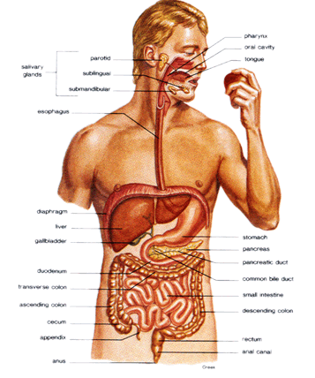
Physical or Chemical?
Digesting an Apple

Slide 11
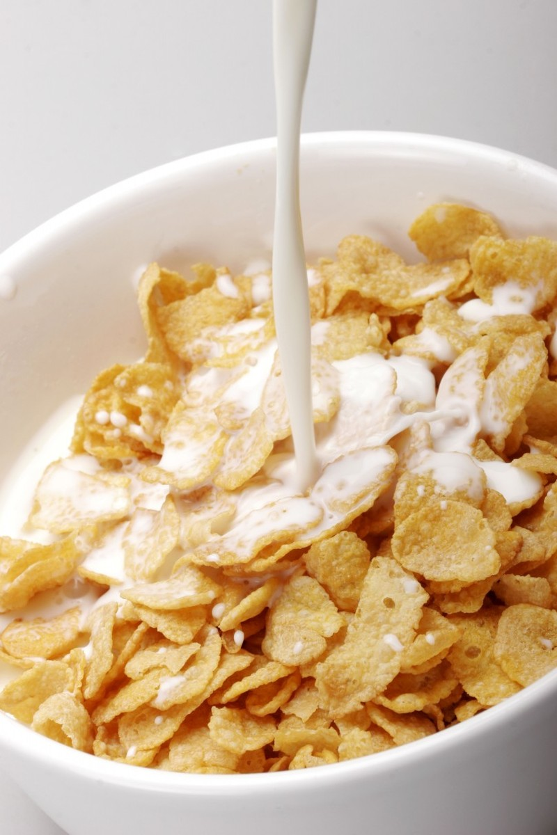
Physical or Chemical?
Pouring Milk on Your Cereal

Slide 12
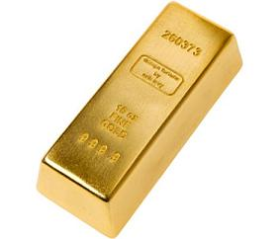
Which state of matter?

Slide 13
Which state of matter?
Particles are close together and can only vibrate

Slide 14
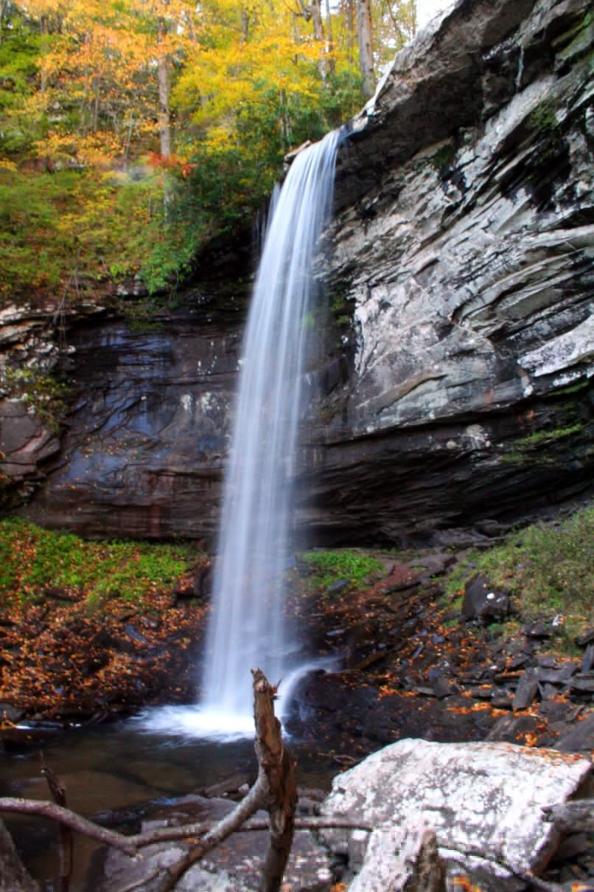
Which state of matter?

Slide 15
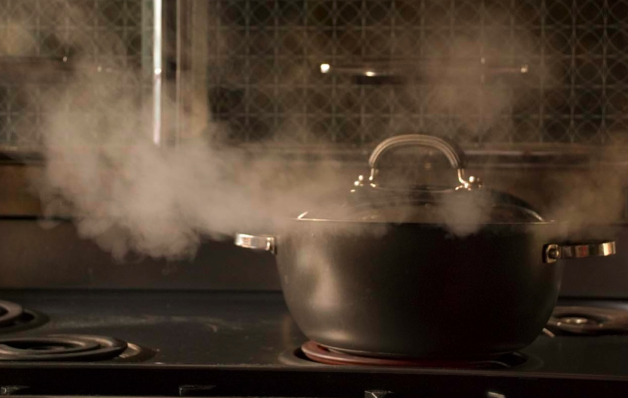
Which state of matter?

Slide 16
Which state of matter?
Particles are far apart and always in motion

Slide 17
Which state of matter?

Slide 18
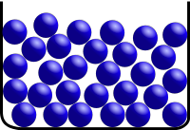
Which state of matter?

