Slide 1
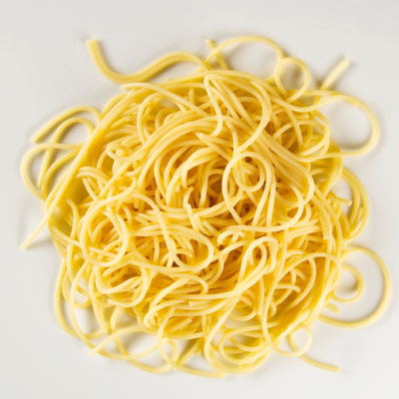
Catalyst
Describe the object using the following physical properties:
Color
Shape
Texture
Flexibility
Luster
Cooked Spaghetti

Slide 2
Physical and Chemical Changes

Slide 3
Review

Slide 4
Today’s Notes
Proper Heading!!!
First and Last Name
Date
Class
Physical and Chemical Changes

Slide 5
Physical Property
A physical property is a characteristic that can be observed without changing the substance you have.
Examples: color, conductivity, brittleness

Slide 6
Chemical Property
A chemical property is a property that can only be observed by changing the material you have.
Examples: reaction with acid, ability to burn

Slide 7
Physical Change
A physical change is a change that only affects a material’s physical properties.
Examples: cutting hair, breaking a stick, melting ice

Slide 8
Chemical Change
A chemical change is a change that creates something new.
Examples: burning paper, baking a cake

Slide 9
Practice
Red=Physical
Blue= Chemical

Slide 10
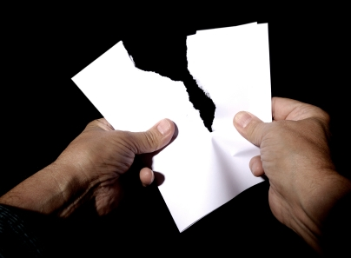
Red= Physical Blue= Chemical

Slide 11
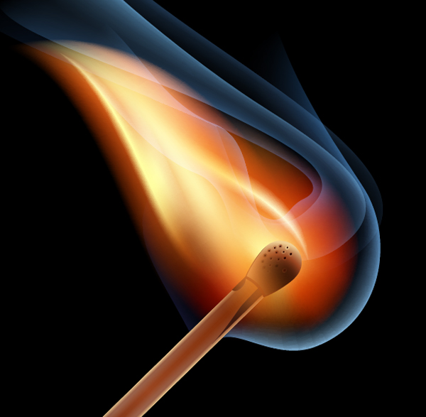
Red= Physical Blue= Chemical

Slide 12
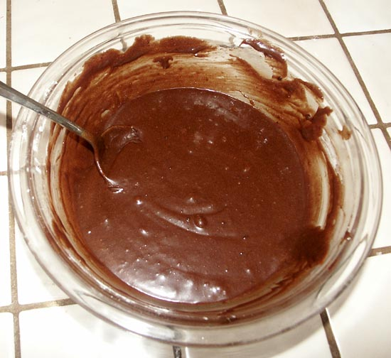
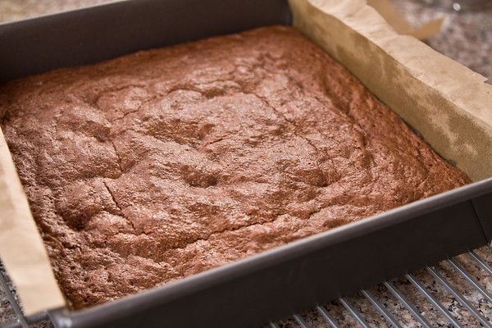
Red= Physical Blue= Chemical

Slide 13
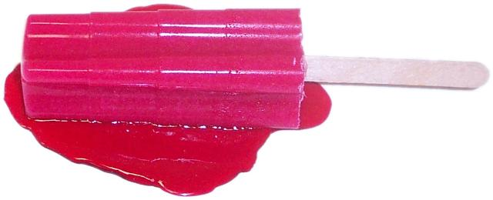
Red= Physical Blue= Chemical

Slide 14
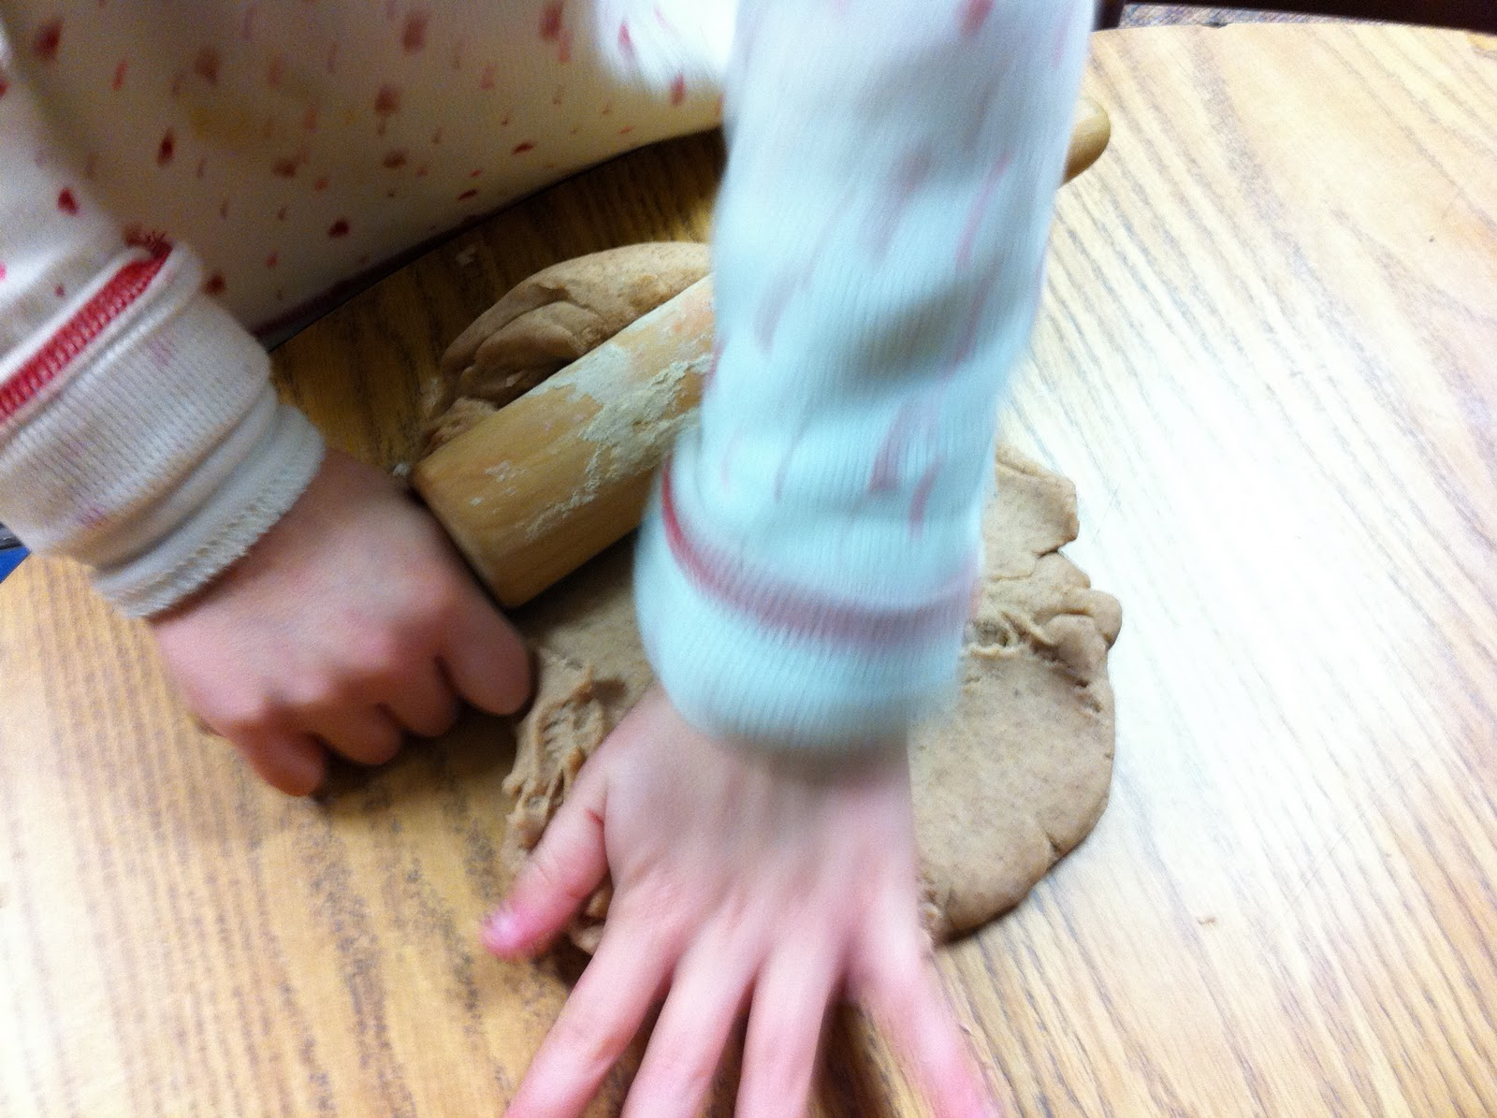
Red= Physical Blue= Chemical

Slide 15
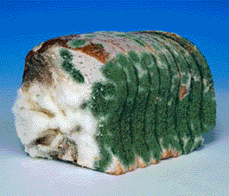
Red= Physical Blue= Chemical

Slide 16
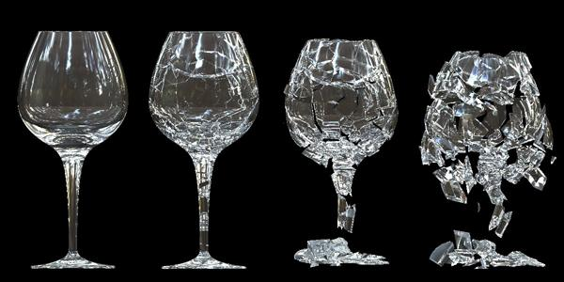
Red= Physical Blue= Chemical

Slide 17
Red= Physical Blue= Chemical

Slide 18
Foldable
Outside
Physical Property
Chemical Property
Physical Change
Chemical Change
Inside
TOP: Definition in your own words
BOTTOM: Picture with caption and/or explanation

Slide 19
Homework
Two Ways to Change WS

Slide 20
Catalyst
Write two things that the Periodic Table can tell you.

