Slide 1
Day one
Chapter 16 – Human Impact on Ecosystems

Slide 2
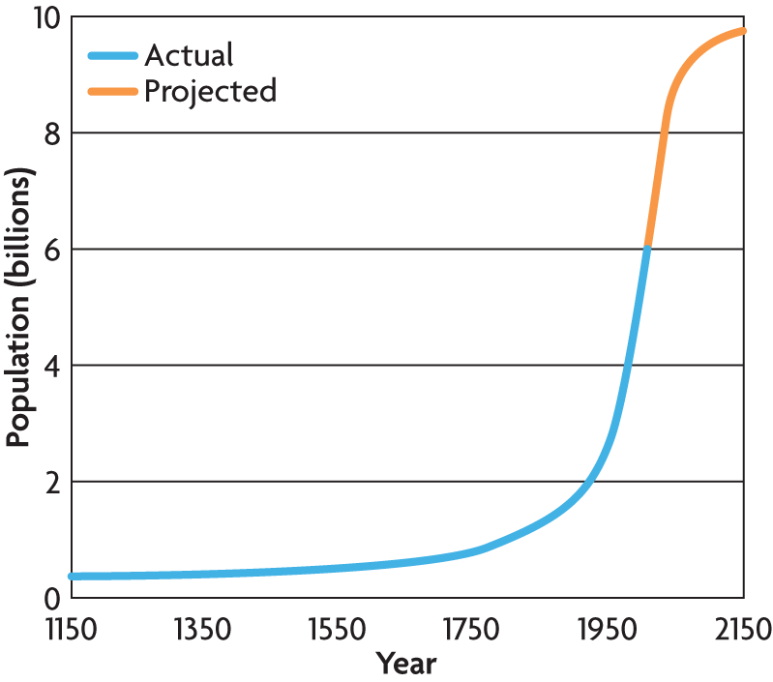
Earth’s resources
As the human population grows, the demand for resources increases.
Our population continues to grow.
Earth’s carrying capacity is actually unknown.
What is carrying capacity?
Largest number of individuals an environment can support
Earth’s population is around 6 billion.

Slide 3
Technology and Human Population
As humans modify their environment through
Agriculture
Transportation
Medical advances
Sanitation
Examples of technology:
Gas powered farm equipment – makes possible for the production of large quantities of food
Antibiotics and aseptic cleansers – reduced infant mortality rates
Carrying Capacity Has Greatly Increased

Slide 4
Types of Resources
Growing human population exerts pressure on Earth’s natural resources
Oil
Coal
Buildup of dead organisms over millions of years provides humans with oil and coal
Currently support the majority of our country’s energy use. Both are products of natural processes.

Slide 5
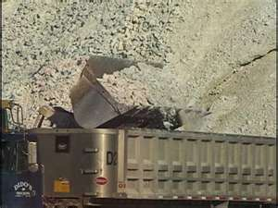
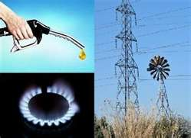
Nonrenewable Resources
Cannot be replenished by natural processes
Used faster than they form
Examples:
Oil
Coal
Natural gas
Growing use of this resource will eventually lead to an energy crisis
Fun fact: In 2006, humans were using oil at a rate of about 77 million barrels per day.

Slide 6
Nonrenewable Resources

Slide 7
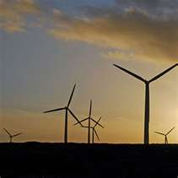
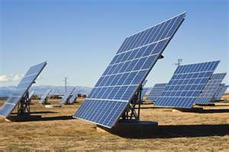
Renewable Resources
Are replaced or generated over time
Cannot be used up or replenish themselves over time
Examples:
Wind energy captured by wind turbines
Solar energy captured by solar panels

Slide 8
Renewable Resources

Slide 9
Limits of Resources
Renewable resources are NOT NECESSARILY unlimited!
Fresh water is renewable but can become limited by drought or overuse.
Fossil fuels form over hundreds of millions of years from deeply buried organic materials…when they are depleted, they are gone forever!!!!

Slide 10
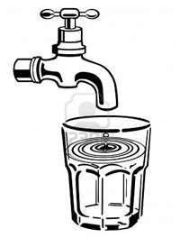
Drinking Water – As Renewable Resource
Pollution and overuse threaten its supply
Pesticides
Industrial waste
Other contaminants
In 1900, 25,000 American’s died of typhoid. By 1960, thanks to the use of chlorine in water treatment, that number dropped to 20.
Found in water sources that supply tens of millions of people across the country

Slide 11
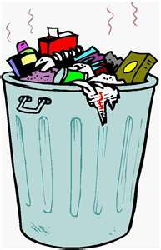
As human population grows…
Fun Fact: United States uses more resources and produces more waste than any country on Earth
Fun Fact: U.S. generates about 230 millions tons of garbage
4.2 pounds per day, per person, or almost 1 ton per year

Slide 12
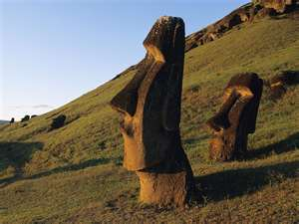
Sustainable Use
Is a way of using natural resources at a rate that does not deplete them
A sustainable system operates without causing long-term harm to the ecological resources on which it depends.
Example:
alternative methods of pest control
contour planting
aquaculture
Effective Management: Think about Easter Island…an irresponsible use of resources!

Slide 13
Ecological Footprint
Ecological Footprint –
Amount of land needed to support a person
The land must produce and maintain enough
food and water
Shelter
energy
waste
Size of ecological footprint depends on several factors

Slide 14
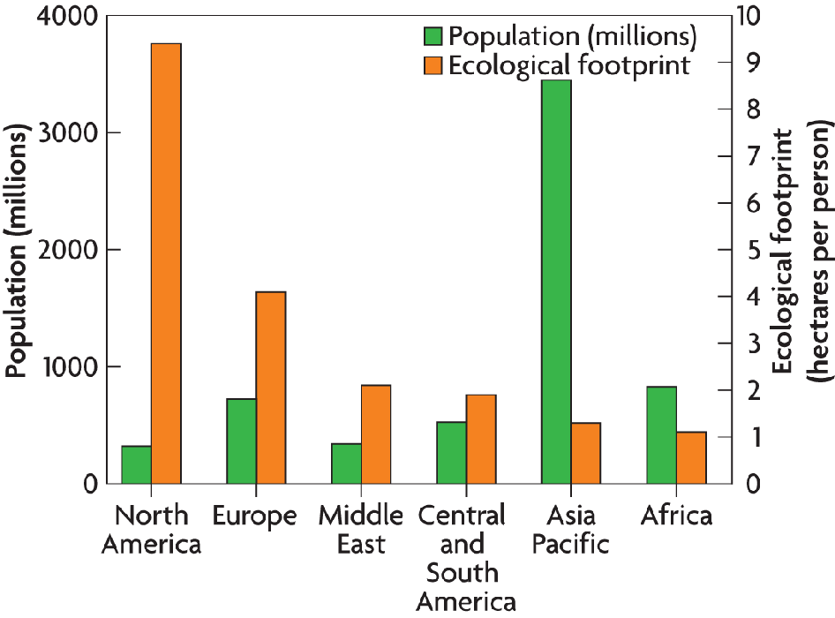
Factors that affect Ecological Footprint
Amount and efficiency of resource use
Amount and toxicity of waste produced
Average American citizen’s ecological footprint covers an area large than 24 football fields. Largest in the world.

Slide 15
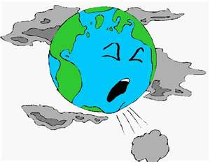
Pollutants accumulate in the air
We add synthetic chemicals and materials to the Earth each year.
What is pollution?
Describes any undesirable factor, or pollutant, that is added to the air, water, or soil
Examples of pollutants:
Microscopic air particles
Waste products from factories
Household chemicals
Pollution can be immediate or delayed over time

Slide 16
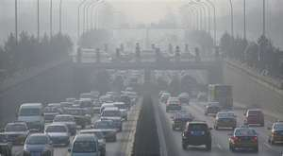
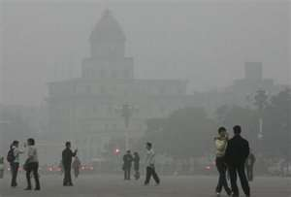
Air Pollution
Most common air pollution comes from the waste products produced by burning fossil fuels such as gas and oil.
Smog is one type of air pollution.
sunlight interacts with pollutants in the air
pollutants produced by fossil fuel emissions
made of particulates and ground-level ozone

Slide 17
Air Pollution
Ozone is the principal component of smog
Harmful to organisms
Plays protective role in Earth’s upper atmosphere
Shields against harmful UV light from sun

Slide 18
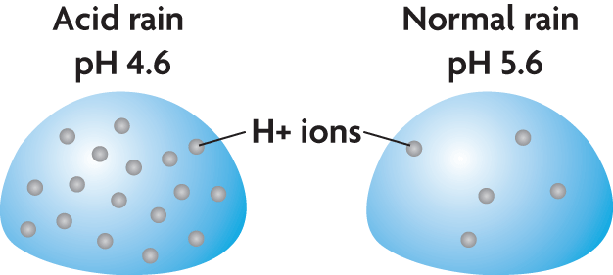
Air Quality
Smog can be harmful to human health.
Acid rain is caused by fossil fuel emissions.
produced when pollutants in the water cycle cause rain pH to drop
can lower the pH of a lake or stream
can harm trees

Slide 19
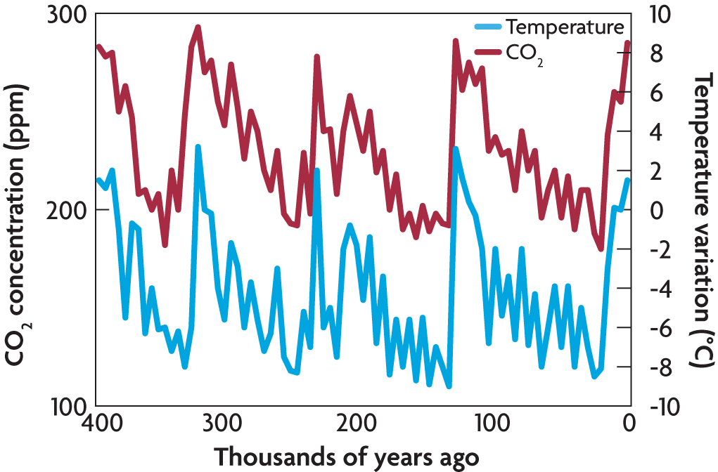
Air Quality
Air pollution is changing Earth’s biosphere.
The levels of atmospheric carbon dioxide rise and fall over time.
High levels of carbon dioxide are typical of Earth’s warmer periods.

Slide 20
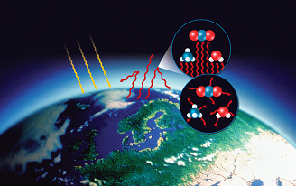
Air Quality
The greenhouse effect slows the release of energy from the Earth’s atmosphere.
sunlight penetrates Earth’s atmosphere
energy is absorbed and reradiated as heat
greenhouse gases absorb longer wavelengths
greenhouse gas molecules rerelease infrared radiation
carbon dioxide (CO₂)
methane (CH₄)
water (H₂O)

Slide 21
Greenhouse Effect

Slide 22
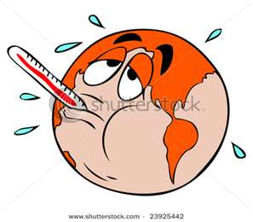
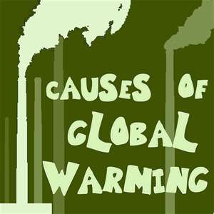
Global Warming
Global warming refers to the trend of increasing global temperatures.
Over the past 100 years, the average global temperature has risen 0.6 degrees Celsius
Most dramatic change occurring over the past 46 years!
What is causing the rise in temperature change known as global warming?
Result of increased levels of greenhouse gases such as carbon dioxide, water, and methane
Results for industry and automobile usage
Threatens ecosystems around the world

Slide 23
Something to help you remember!

Slide 24
Ticket out the Door
What is the Earth’s population?
What are four ways humans have caused the carrying capacity of Earth to increase?
What is a nonrenewable resource?
What is a renewable resource?
What is a sustainability?
What is an ecological footprint?

Slide 25
Day two
Chapter 16 – Human Impact on Ecosystems

Slide 26
Water Pollution
Water pollution affects ecosystems.
Pollution major impact on ecosystems
Examples:
Raw sewage
Trash
Runoff from farms and cities
Disrupts chemical balance of freshwater ecosystems
Causing algal blooms

Slide 27
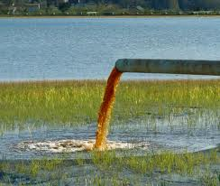
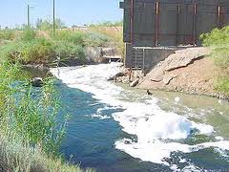
Water Pollution
Degrades aquatic habitats in streams, lakes, and oceans
Excess fertilizers and animal waste get into streams and cause algal blooms
Coral reefs are destroyed when silt covers the living coral and they can’t photosynthesize or get to food
Detergents, heavy metals, and industrial chemicals in runoff cause sickness and death in aquatic organisms
Abandoned drift nets trap dolphins, whales, fish, sea turtles

Slide 28
Water Pollution

Slide 29
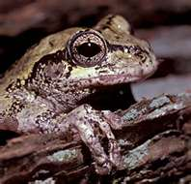
Indicator Species
Way in which scientists can determine the health of an ecosystem
Also known as a bioindicator
Defined as a species that provides a sign, or indication, of the quality of the ecosystem’s environmental conditions
Examples: Frogs – skin comes into contact with water; pollution can cause tumors

Slide 30
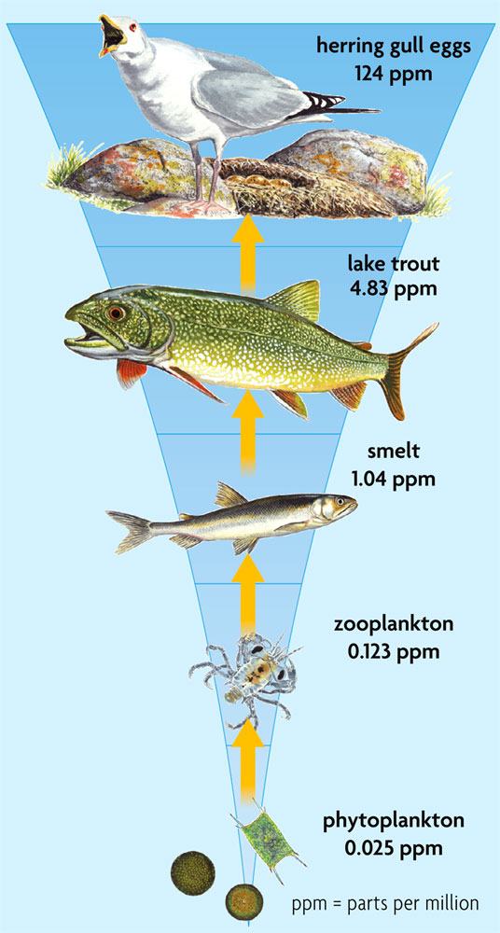
Biomagnification
Causes accumulation of toxins in the food chain
Defined as a pollutant that moves up the food chain as predators eat prey accumulating in higher concentrations in the bodies of predators
Pollution is measured in parts per million (ppm)
Most serious effect on species near the top of the food chain

Slide 31
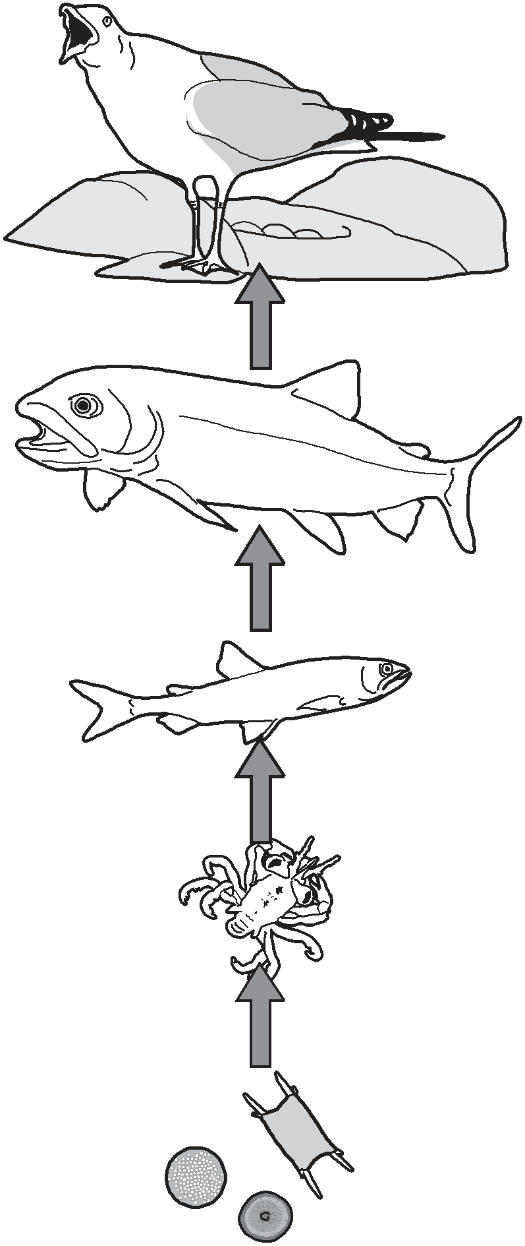
Biomagnification
Herring gull eggs 124 ppm
The movement of fat-soluble pollutants through a food chain results in higher concentration in the top consumer.
Measured in Parts per million (ppm)
Lake trout
4.83 ppm
Smelt
1.04 ppm
Zooplankton
0.123 ppm
Phytoplankton
0.025 ppm

Slide 32
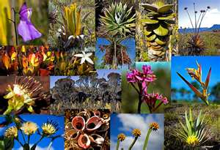
Biodiversity
Why is biodiversity important?
Sum total of the genetically based variety of all organisms in the biosphere
Reason 1: It is the foundation of much of our world
Reason 2: Many medical and technological advancements come from nature
Reason 3: Loss of biodiversity has long term effects. When it is gone, it is gone forever!
It reduces stability and makes it more difficult for the ecosystem to handle future change

Slide 33
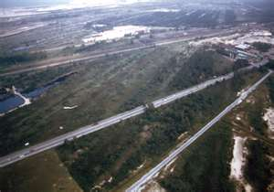
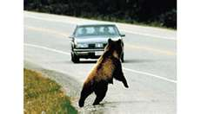
Threats to Biodiversity
Loss of habitat can eliminate a species
Habitat Fragmentation
Occurs when a barrier forms that prevents an organism from accessing its entire home range
“Biological Island”
Caused by the building of roadways or the harvesting of forests

Slide 34
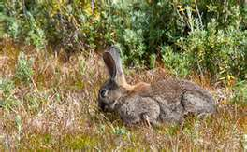
Threats to Biodiversity
Introduced species can disrupt stable relationships in an ecosystem
Defined as any organism that was brought to an ecosystem as the result of human actions
Also called an invasive species
Can prey or crowd out native species

Slide 35
Biodiversity

Slide 36
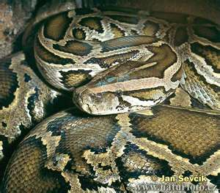
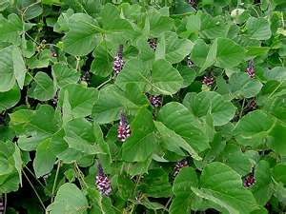
Introduced Species
Species | Where Introduced | Problems Caused
Burmese python – Came as a pet species | Florida Everglades (originally from SE Asia) | Feeds on small animals such as rats, birds (endangered), raccoons, and even dogs
Kudzu -Introduced as a native houseplant | SE United States (also from SE Asia) | Chokes out native plants
Common house mouse | Australia (originally from Europe) | Eat crops of corn and grains; Populations grow exponentially

Slide 37
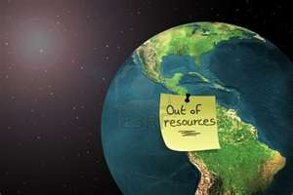
Sustainable Development
Manages resources for present and future generations
Defined as the practice in which natural resources are used and managed in a way that meets current needs without hurting future generations

Slide 38
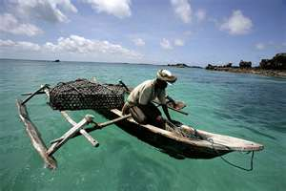
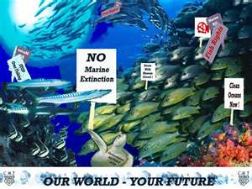
Practices in Fishing Industry
Rotation
Rotate between fish species
Fishing gear review
Gear can damage the sea floor
Harvest reduction
Slowing the harvest allows more growth time
Fishing bans

Slide 39
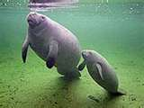
Umbrella Species
Conservation practices focus on a few species but benefit entire ecosystems
Defined as species whose being protected under the Endangered Species Act leads to the preservation of its habitat and all of the other organisms in its community
Western Indian Manatee

Slide 40
Important Environmental Laws
Clean Air Act –
Signed into law in 1970, helped increase air quality; regulates emissions from factories and automobiles
Clean Water Act –
Signed into law in 1972, provides safe waterways for swimming and drinking
Endangered Species Act –
Signed into law in 1973, provides safety for animals in danger of becoming extinct

Slide 41
Human Can Protect the Environment
Ability to control how fast our population grows by controlling birth rates
Develop technology to produce more food and produce less waste
Take action to protect and maintain ecosystems

Slide 42
Ticket out the Door
What is an indicator species?
Name one example of an indicator species and how it lets us know the environment has possible pollution.
Where is the most serious biomagnification effect in a food chain?
What is an introduced species?
Name one example of an introduced species and how it harms the environment.

